Slide 1
Keynote Address
&
Awards Ceremony

Slide 2
Thank you
Madeline Walsh
Program Associate, Oracle Corporate Citizenship

Slide 3
The Person In Person-Centered Service

Slide 4
Food insecure
11.8 percent (15.0 million) of U.S. households were food insecure at some time during 2017.
Low food security
7.3 percent (9.3 million) of U.S. households had low food security in 2017.
Very low food security
4.5 percent (5.8 million) of U.S. households had very low food security at some time during 2017.
https://www.ers.usda.gov/topics/food-nutrition-assistance/food-security-in-the-us/key-statistics-graphics.aspx
Notes:
Food insecure—At times during the year, these households were uncertain of having, or unable to acquire, enough food to meet the needs of all their members because they had insufficient money or other resources for food. Food-insecure households include those with low food security and very low food security.
11.8 percent (15.0 million) of U.S. households were food insecure at some time during 2017.
Down from 12.3 percent in 2016.
Low food security—These food-insecure households obtained enough food to avoid substantially disrupting their eating patterns or reducing food intake by using a variety of coping strategies, such as eating less varied diets, participating in Federal food assistance programs, or getting emergency food from community food pantries.
7.3 percent (9.3 million) of U.S. households had low food security in 2017.
Essentially unchanged from 7.4 percent in 2016.
Very low food security—In these food-insecure households, normal eating patterns of one or more household members were disrupted and food intake was reduced at times during the year because they had insufficient money or other resources for food.
4.5 percent (5.8 million) of U.S. households had very low food security at some time during 2017.
Down from 4.9 percent in 2016.

Slide 5
These are the individuals you care for, design programs for and create security where there is little to none…admirable, profound and important work.

Slide 6
Fundraising
New Services
Client Centric Philosophy
Donations
Too many needs
Are we making a difference?

Slide 7
Who cares for the caregivers?

Slide 8
Phases of Fatigue
Champion Phase
Irritant Phase
Withdrawal Phase
Walking Wounded Phase
Victim Phase

Slide 9
Education Compassion Fatigue
Chronic exhaustion (emotional, physical, or both)
Reduced feelings of sympathy or empathy
Dreading working for or taking care of another
Feelings of irritability, anger, or anxiety
Depersonalization
Hypersensitivity or complete insensitivity to emotional material
Feelings of inequity toward the therapeutic or caregiver relationship
Headaches, trouble sleeping, weight loss
Impaired decision-making
Problems in personal relationships
Poor work-life balance
Diminished sense of career fulfillment

Slide 10
PRACTICE SELF-CARE

Slide 11
SET EMOTIONAL BOUNDARIES

Slide 12
BOOST YOUR RESILIENCY

Slide 13
ENGAGE IN HOBBIES
CULTIVATE FRIENDSHIPS
JOURNAL YOUR EMOTIONS

Slide 14
DEVELOP WORK PLACE STRATEGIES
USE POSITIVE COPING STRATEGIES
KNOW WHEN TO ASK FOR HELP

Slide 15
Take-Away
Fatigue will not be curbed only by increasing individuals’ personal resilience. Organizational systems must be
re-designed as well.

Slide 16
Work Environment
Social Support
Connection
to Purpose
Leadership
Reduce chaos in the work environment
Avenues for input
No tolerance for abusive behavior
Build community at work
Space to share the emotional toll of caregiving
Create a culture of wellness
Increase flexibility
Adopt compassion practices
Share stories
Understand what matters most to staff – Don’t know? ASK
Nurture a feedback-rich culture
Measure success quantitatively & qualitatively

Slide 17
But Compassion without self compassion is meaningless

Slide 18
Remember….
Be Kind to One Another
Touch Each Life Gently
Find Compassion in the Small Things
And Most of All Remember….

Slide 20
Partnership Awards
Tometrius Paxton
Senior Manager of Community Partnerships

Slide 21
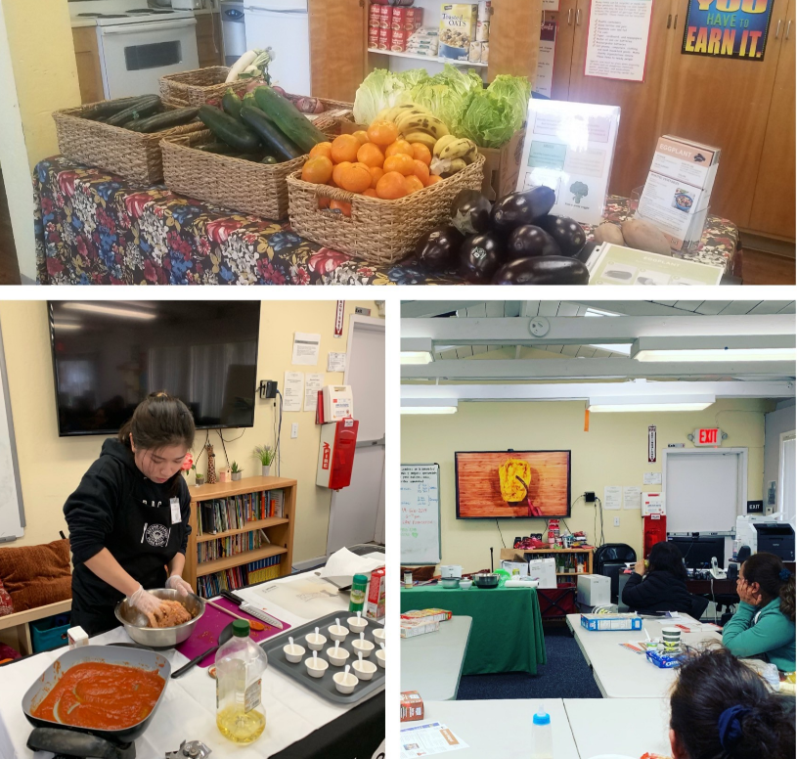
Rising Star Nutrition Champion Award
Project Access

Slide 22
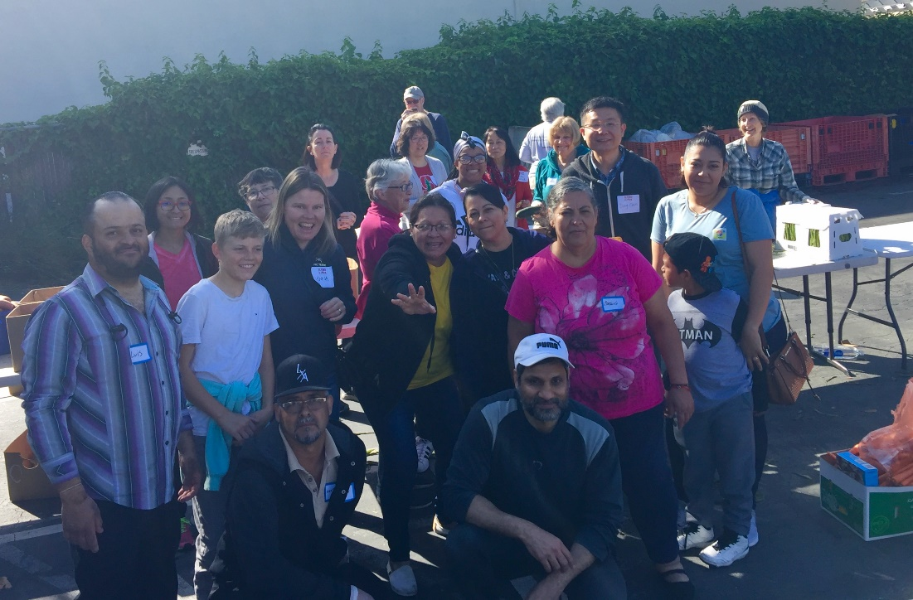
Ultimate Food Connector Award

Slide 23
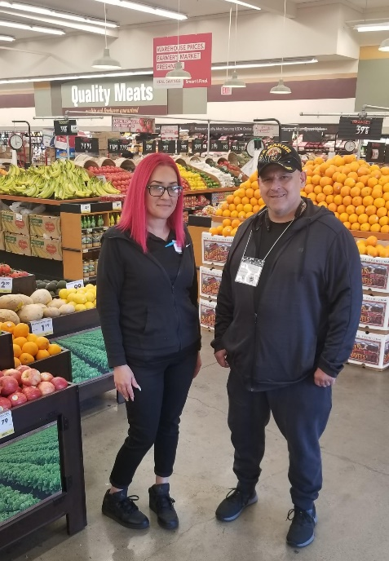
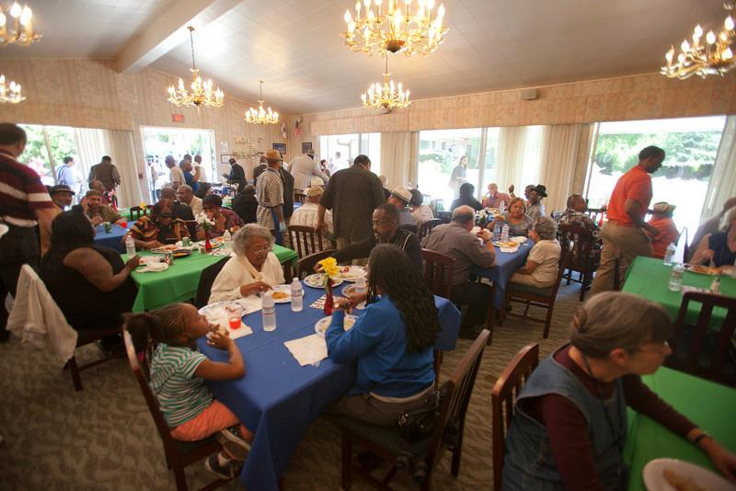
Outstanding Grocery Rescue Partner
Homeless Veterans
Emergency Housing Facility

Slide 24
McCown-Takalo Hunger Hero
Honesty, compassion, integrity
Spokesperson for the underserved
Creative problem solver
Always puts the needs of the clients first

Slide 25
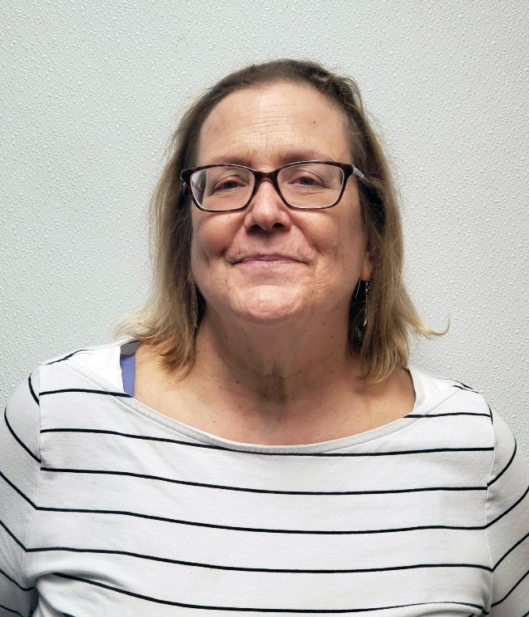
McCown-Takalo Hunger Hero
Mary Ruth Batchelder
La Comida de California

Slide 26
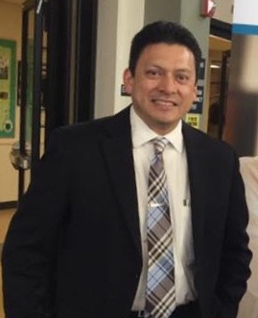
McCown-Takalo Hunger Hero
Adolfo Leiva
Cañada College

Slide 27
Thank you for coming!
Please fill out your survey and
drop it at the registration table
before you leave
You can also take the survey on Attendify!

