Slide 1
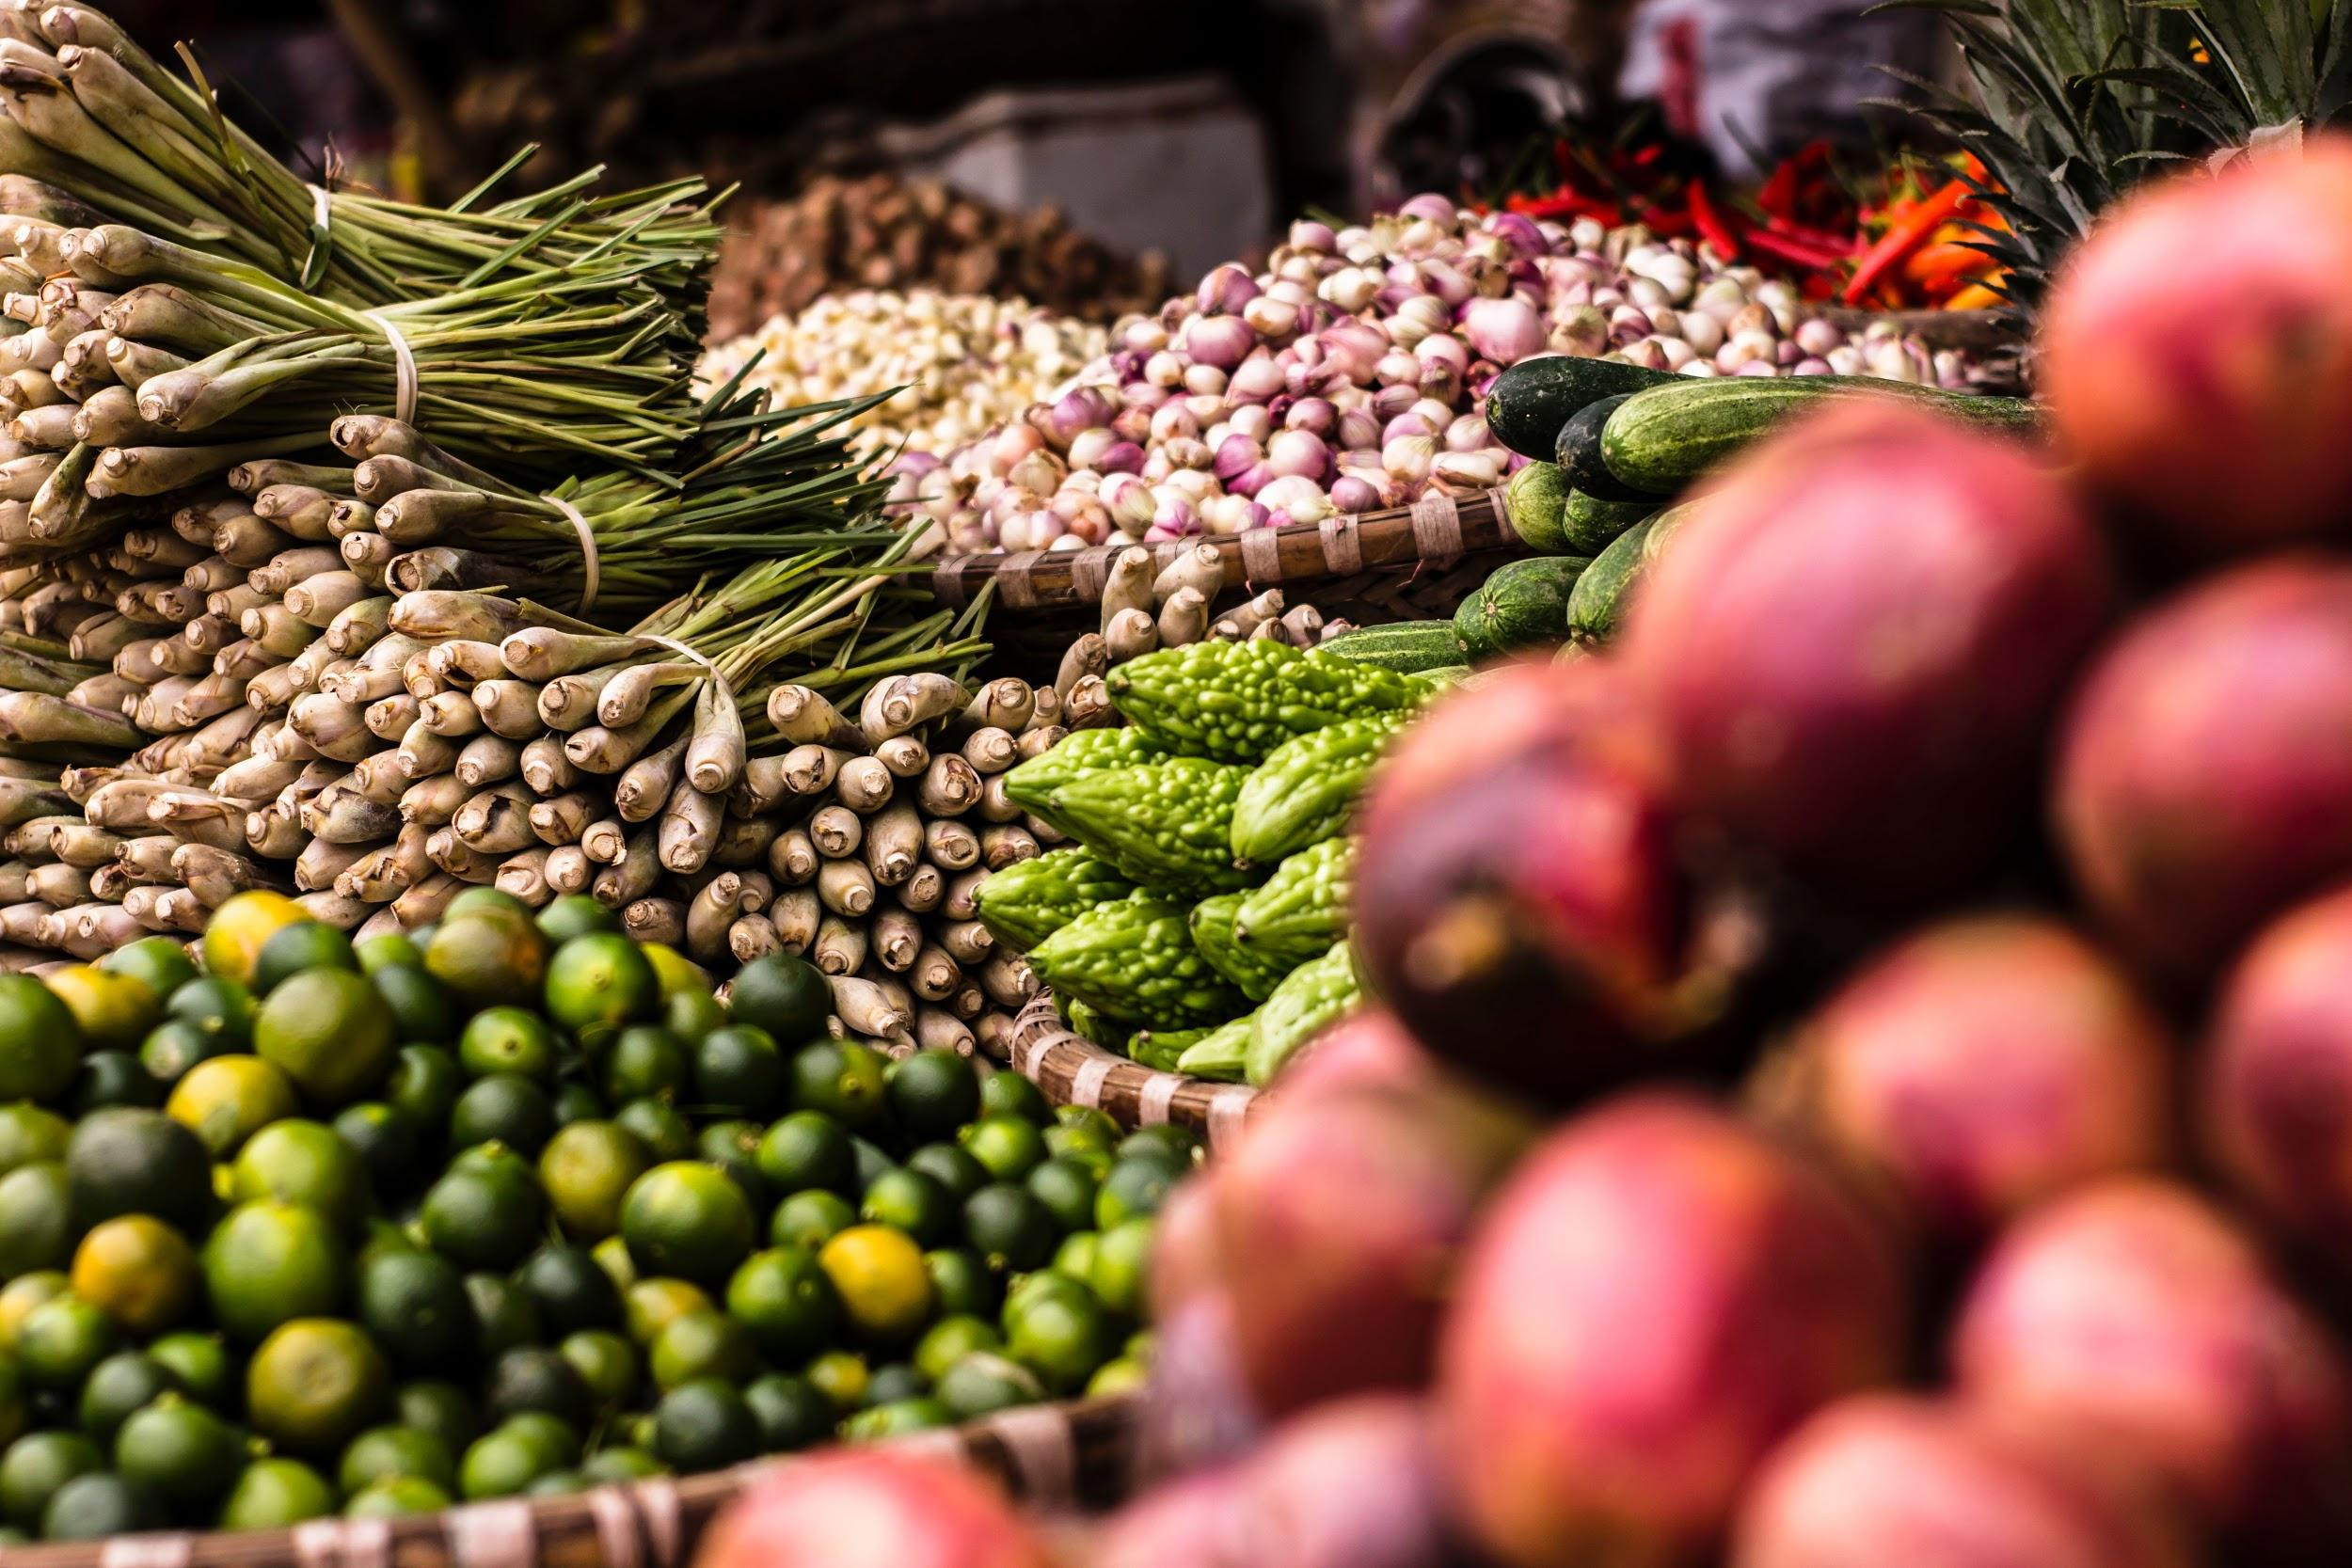
Nutrition in Action:
Nudging your clients for a more wholesome experience
Ruthi Solari
May 3, 2019
Notes:
Nutrition in Action: “Nudging” Your Clients for a More Wholesome Experience. Get tips to empower clients to make the healthy choice the easy choice, discover resources to support clients in cooking on a budget and learn simple ways to showcase your food and tips to reduce waste through understanding expiration dates.

Slide 3
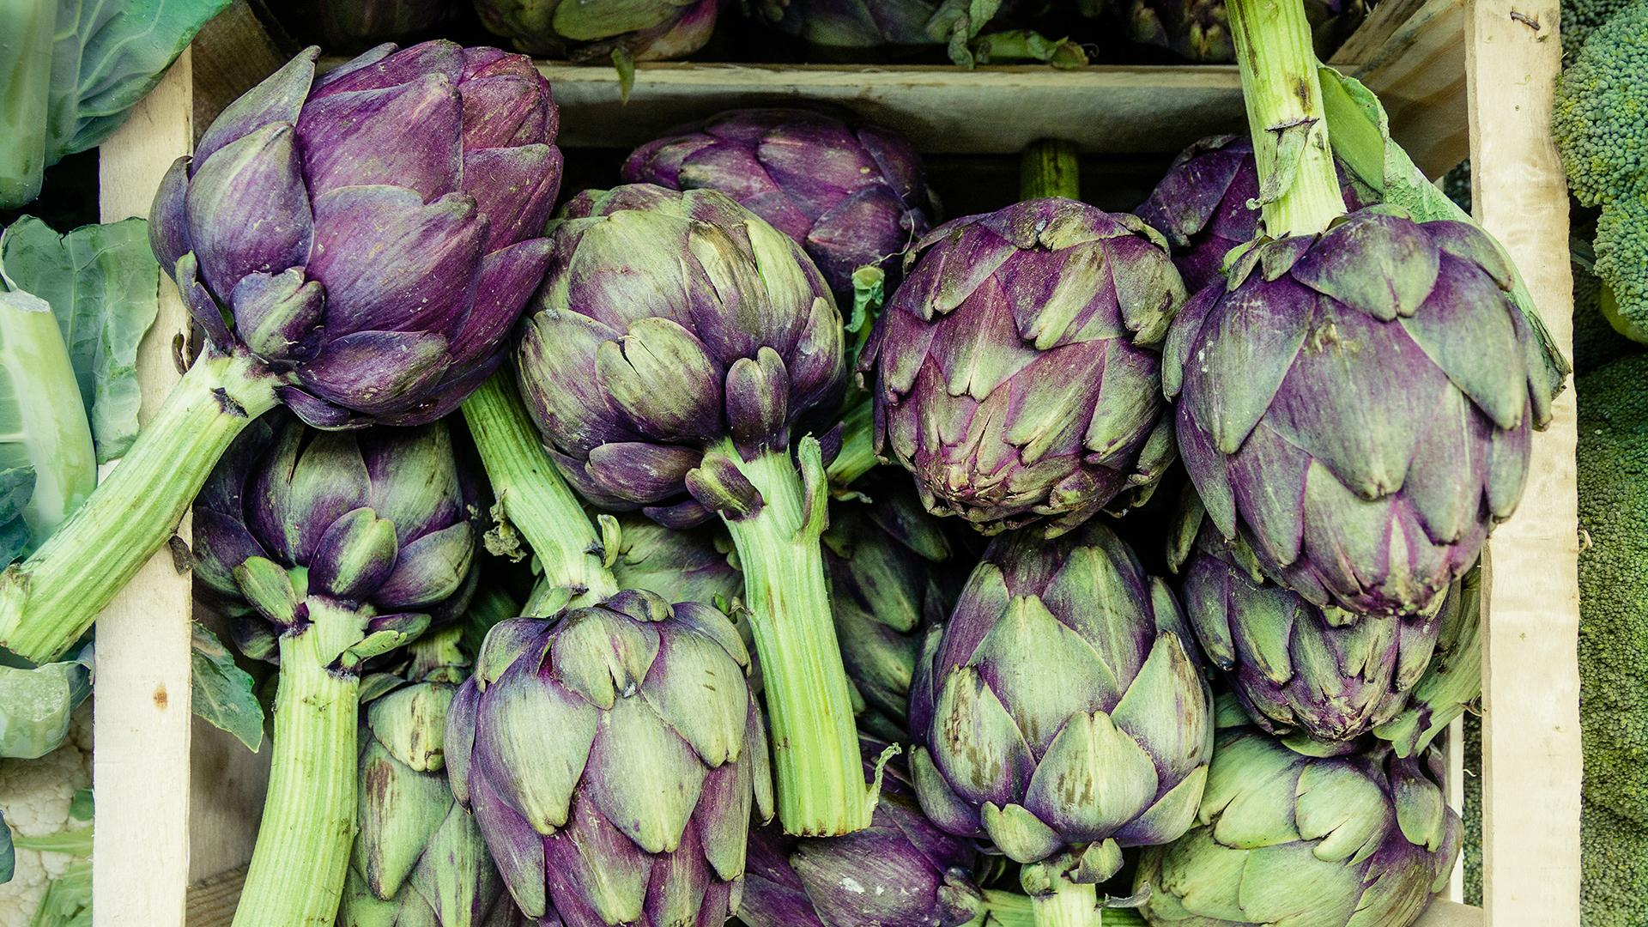
STRATEGIES
Develop nutrition and cooking resources to support healthy, sustained behavior changes.
Implement innovative programs to foster healthy, supportive environments.
Build capacity of partner organizations to best serve their communities.

Slide 4
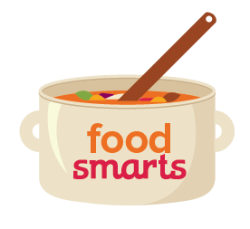
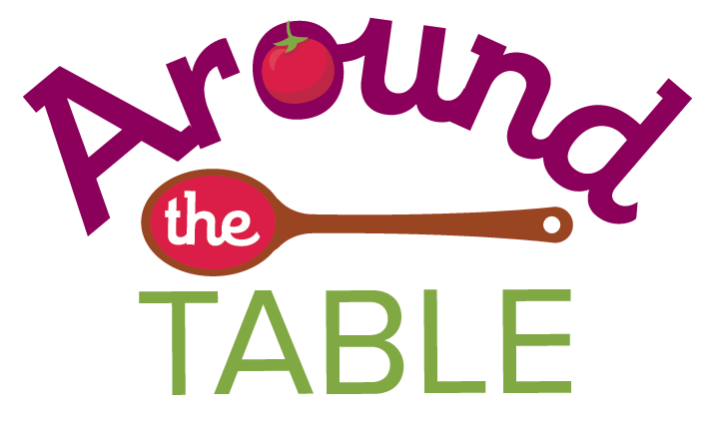
Products and Programs

Slide 5
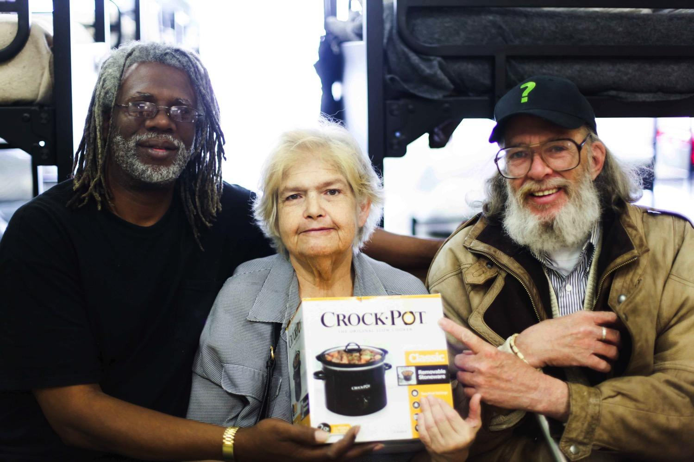
Food Security + Public Health Nutrition = Nutrition Security
Notes:
Our shorthand definition of nutrition security is to combine food security with pubic health nutrition.
We believe that food security strategies – whether CalFresh/SNAP benefits or the charitable food network – can prioritize the long term mental and physical health of vulnerable individuals while still meeting short term needs. Public health nutrition messages can take into account client perspective and exposure to trauma.
These concepts are extremely important in the food pantry network, which as we all know has become a regular and essential source of nutrition for over 50 million Americans.

Slide 6
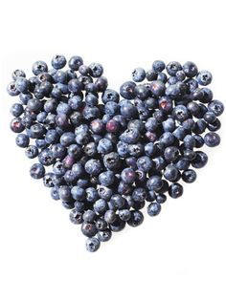
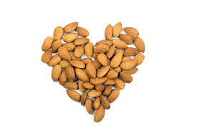
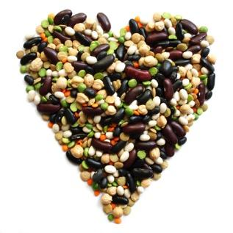
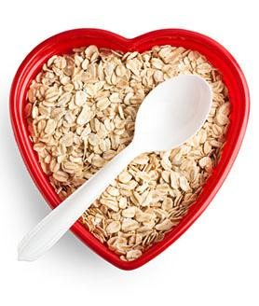
Trauma-Informed Nutrition Security
Notes:
Voice of TI nutrition and nutrition security. Our organization defines our work and wants to shape the field through the principles of TI Nutrition Security:

Slide 7
Pillars Of Food Nutrition Security
Food Resources Sufficient quantities of healthy food available on consistent basis.
Food Access Sufficient resources to obtain appropriate foods for a nutritious, culturally appropriate diet.
Food Use A healthy environment and adequate knowledge to prepare and consume healthy foods.
Stability & Self-Sufficiency
Notes:
The language for how we talk about food security is changing.
For example, here are the three pillars of food security, modified to include words such as healthy and nutritious.
All of these are pillars of self-sufficiency and stability.

Slide 8
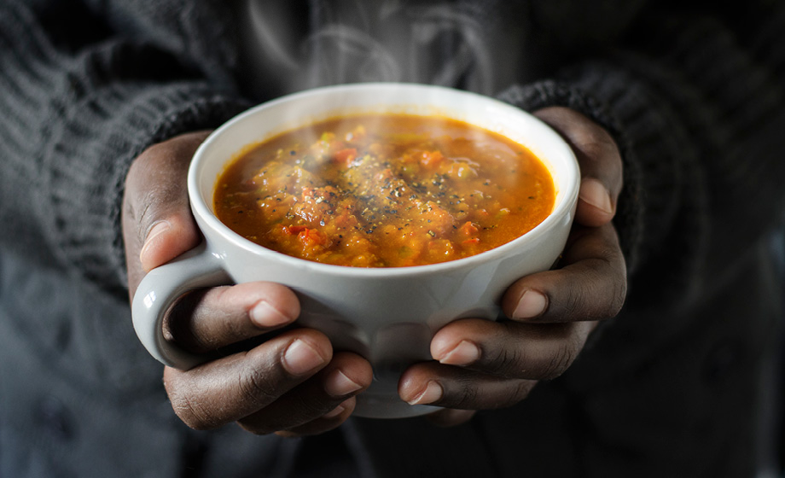
Grounding with Soup Bowl Breathing

Slide 9
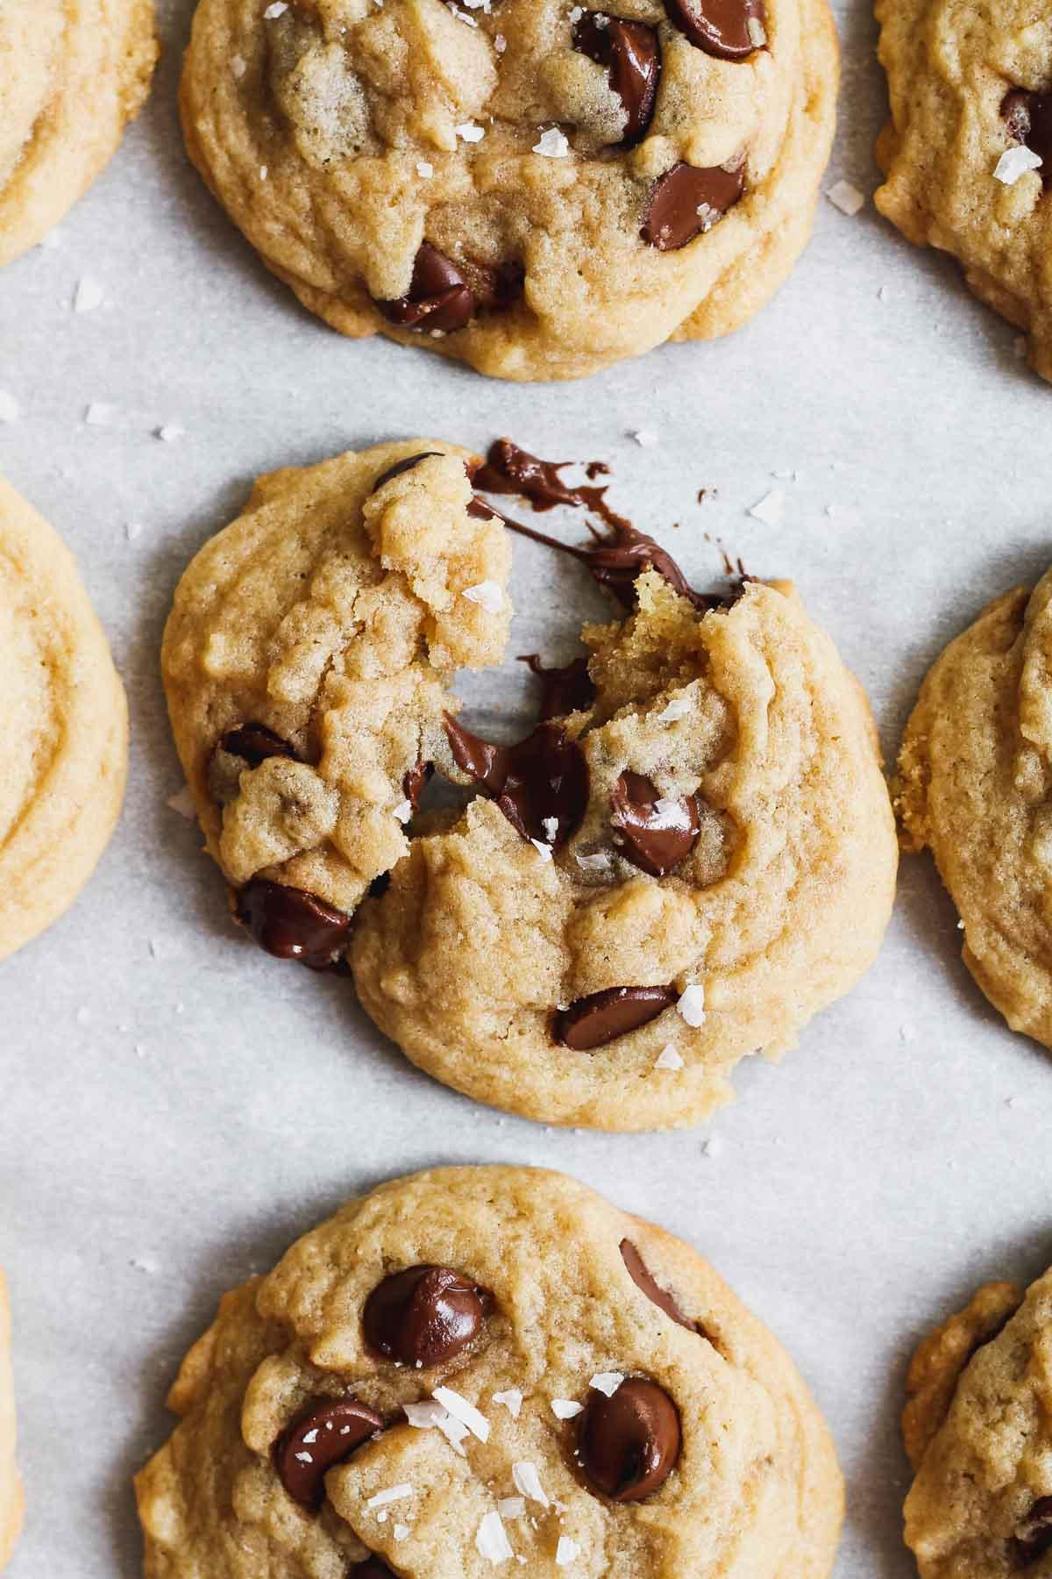
Food Experience
Notes:
chocolate/craving activity--emotional/sensory relationship to food

Slide 11
Recognizing the Impact of Trauma: “What happened to you?”

Slide 12
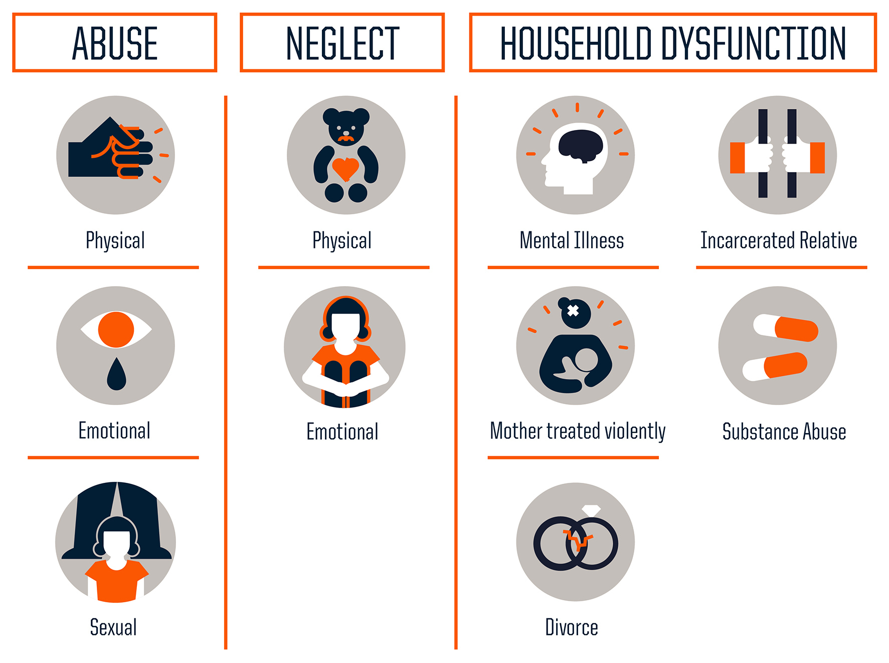
The Original ACEs study
Notes:
Adverse Childhood Experiences // Adverse Community Experiences

Slide 13
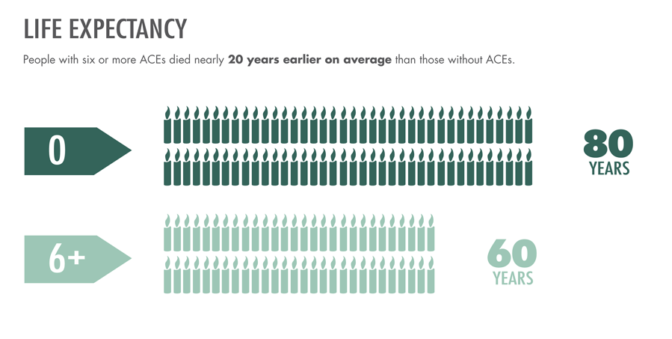
Trauma-ACES Study
LIFE EXPECTANCY: People with six or more ACEs died nearly 20 years earlier on average than those without ACEs.

Slide 14
Implications for Nutritional Health
Early Death
Disease, Disability, and Social Problems
Obesity Heart disease
Diabetes Kidney disease
Adoption of Health-risk Behaviors
Emotional eating Eating calorie-dense foods
Lack of sleep Sedentary lifestyle
Social, Emotional, and Cognitive Impairment
High fat/high sugar cravings Feast vs. famine mindset
Decreased self-regulation
Damaged metabolism Inflammation
Increased body fat Gut-brain circuitry
Disrupted Neurobiology
Adverse Childhood Experiences
MECHANISMS BY WHICH ADVERSE CHILDHOOD EXPERIENCES INFLUENCE HEALTH AND WELL-BEING THROUGHOUT THE LIFESPAN
Notes:
a whole discussion warranted, no time; health and medicine only looks at the top 3

Slide 15
3 Rs of Trauma Informed Nutrition Security
Recognizes the impact of adversity and toxic stress on diet, health behaviors, disease risk, and relationship to food
Resists Retraumatization: Avoids inadvertently creating or reinforcing practical or emotional barriers to nutrition security
Resilience building and healing-centered care through the meaning of food
(adapted from SAMHSA’s 4 R’s of Trauma Informed Services)
Notes:
food and food experiences has this unique place in our lives to be healing

Slide 16
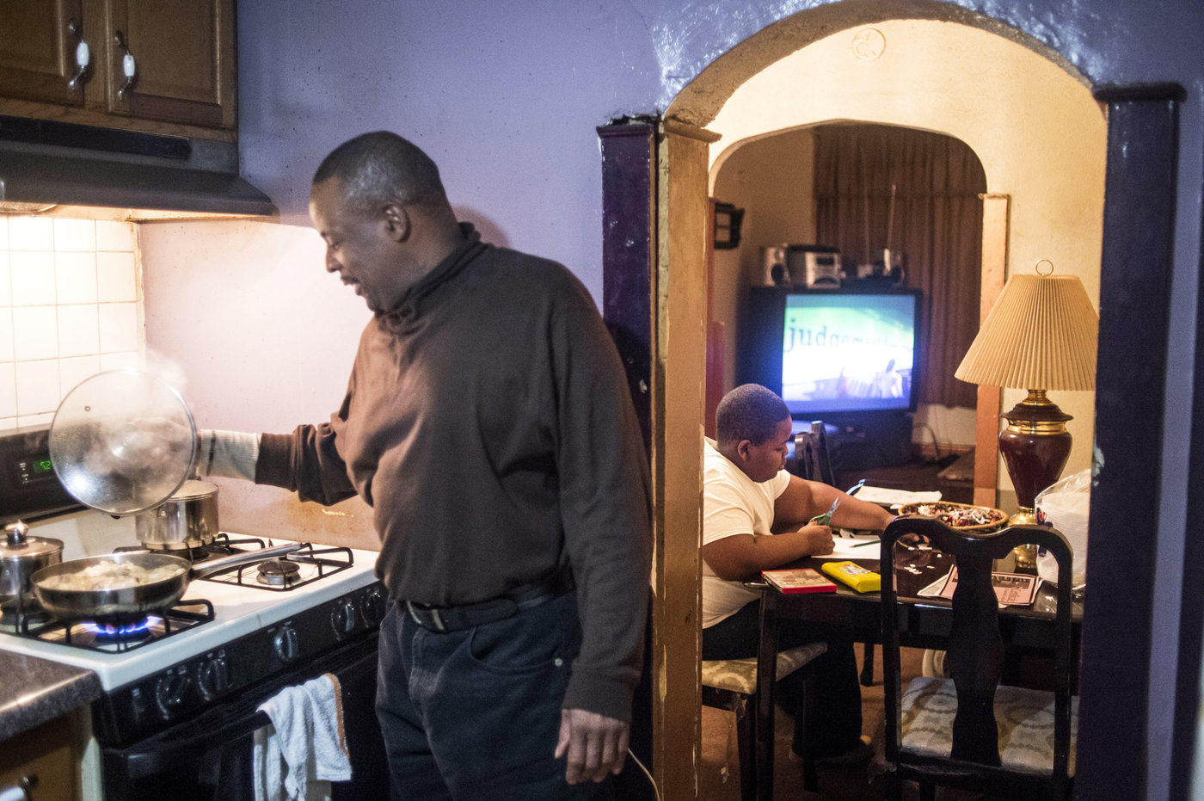
“I started giving him whatever he wanted to make him feel better after all the things he’d been through.”
-Silvester Fullard (father to Tavestiar)
Source: “To head of trauma’s legacy, start young,” NPR, (3/9/2015)
Notes:
through a trauma lens-- emotional reasons, metabolic reasons for behavior and outcomes (multifaceted reasons for Tavestiar’s weight and health issues, some related to what he eats)

Slide 17
Resisting Retraumatization
Notes:
by understanding trauma, be sensitive and conscious; trauma shuts people down, reactivity; not causing harm

Slide 18
Trauma-Informed Organizations Ask…
What do we to:
reduce shame, anxiety, confusion and tension?
promote safety, dignity, joy?
support and inspire healing and a healthy relationship to food?
Notes:
joy--motivator

Slide 19
Barriers to Trauma-Informed Nourishment
Focus on obesity and BMI
Rules, restriction, deprivation, or scarcity mindset
Disregard of client readiness
Lack of cultural humility
Bureaucratic and non-transparent processes
Overemphasis on personal behavior change
“Donation dumping”; poor quality resources
Notes:
instead of these

Slide 20
Prioritize
Client dignity, voice, and needs
Stress reduction
Choice and autonomy
Food in support of mental and physical health, cognitive development
Culturally-relevant, realistic, actionable, and accessible resources and tools
Leveling of power dynamics in interactions
(adapted from SAMHSA’s Principles of Trauma Informed Care)
Notes:
focus on these

Slide 21
Trauma around Food (common with food insecurity)
Unreliability and unpredictability of meals
Loss of autonomy around food choices
Shame, bias, stigma of food assistance
Restriction and Control
Fat shaming
Manipulation, punishment or rewarding with food
Loss of food culture
Food as a tool of oppression
Notes:
Food itself can be a source of trauma or dysregulation

Slide 22
Resilience-Building and Healing-Centered Strategies

Slide 23
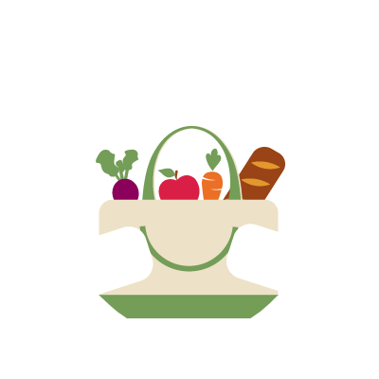
I’m nourished. I’m seen. I’m heard. I matter.
Notes:
starts by putting the client first

Slide 24
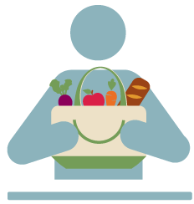
^{Cultural & Dietary} ^{Accommodations}
People of different backgrounds have access to food and information that fits their preferences and health needs.
^{Environment}
^{Clients are warmly welcomed} ^{and healthy options are} ^{easy to access.}
^{Community} ^{Connections}
^{Pantries connect and} ^{collaborate with} ^{the community.}
^{Nutrition} ^{Education}
^{Clients, volunteers, and staff} have access to nutrition and culinary education.
^{Inventory &} ^{Purchasing}
Healthy foods are prioritized for distribution. Pantries support a variety of waste reduction efforts.
^{“I’m nourished. I’m seen.}
^{I’m heard. I matter.”}
^{Nutrition Goals & Pantry Plans}
Policies and procedures are documented and align with a commitment to dignified, healthy distribution.

Slide 25
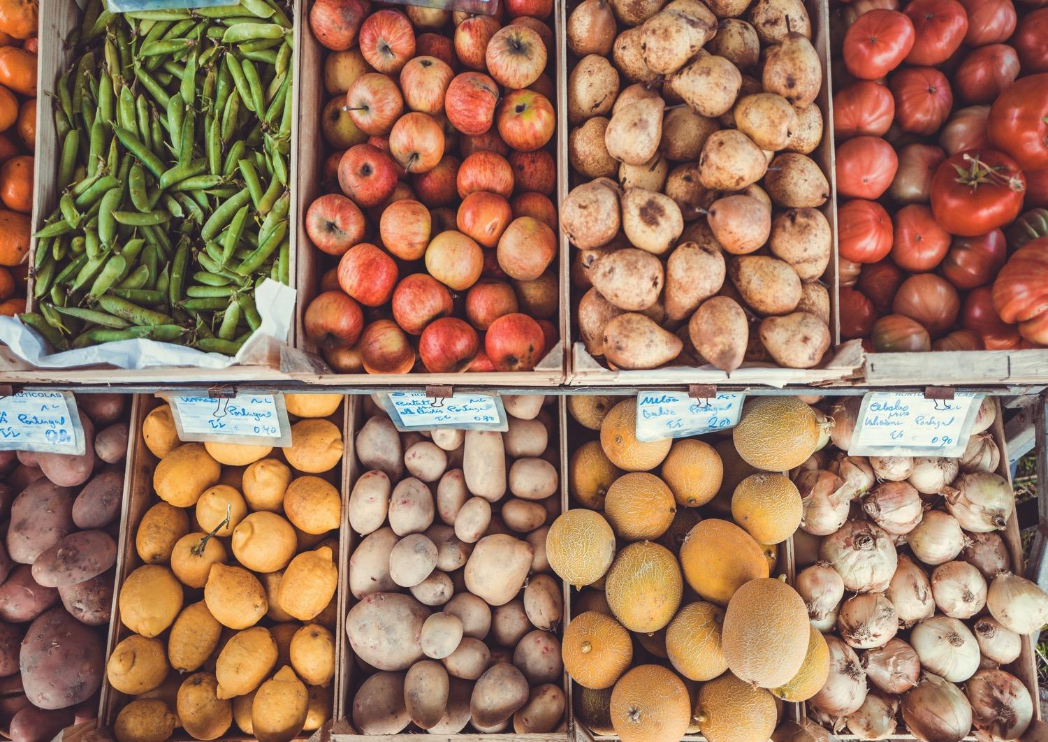
Healthy Food Pantry Visualization

Slide 26
Notes:
Imagine an alien landed in the middle of your pantry (or organization you serve) – how would they know that you prioritize health and that clients were supported in their health? Write down 3-4 things that might tell these aliens that your organization prioritizes health. Think about what food is provided, what would they hear staff and volunteers saying? What does it look like and feel like?
(Volunteer share what they experienced / wrote down)
Who felt that it would be obvious to the visitor that nutrition/health is prioritized? Who felt it might not be too clear?
Brainstorm as a group (write down ideas on paper):
-what are things in your own life that help you eat healthier?
-what have you seen in some of the organizations you’ve worked in that do a good job promoting health in many ways?
(put on our PSE hats) – what are policies or systems to put in place that would promote health in a pantry environment (include for staff and volunteers)

Slide 27
How can a food pantry support health?
What food is provided? (What is NOT there?)
How is the food provided?
What do you hear staff and volunteers saying?
What does it look like? What does it feel like?
What information is provided?
Policies? Systems?
What helps you eat healthier in your home/life?

Slide 28
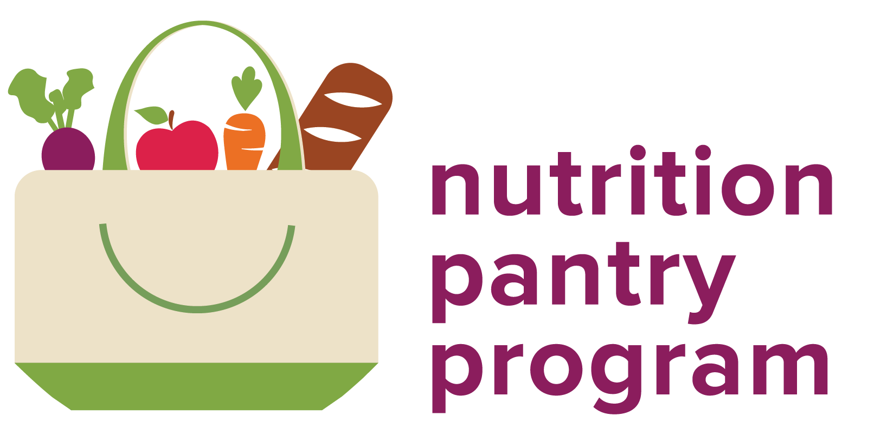
Building, supporting, and certifying a network of client-centered, health-focused food distributions.
Notes:
NPP provides a process for implementing practical, client-centered strategies for a health-focused environment in all types of food distribution sites.

Slide 29
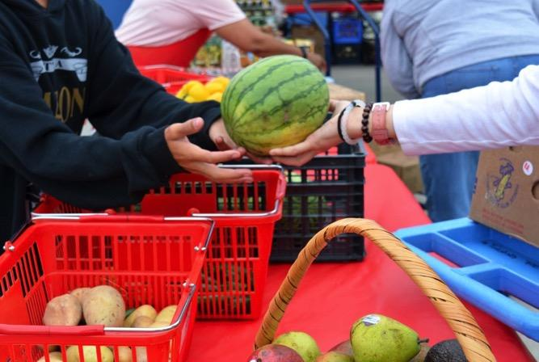
Nutrition Pantry Program Vision
Wherever free food is provided to communities experiencing nutrition insecurity:
the environment is welcoming and responsive to client needs,
the food is nourishing and appropriate,
clients feel confident preparing and consuming these healthier foods.

Slide 30
I’m nourished. I’m seen. I’m heard. I matter.
Notes:
starts by putting the client first

Slide 31
Client-centered Approach
How do you know if you’re using a client-centered approach?
You ask questions, listen, and respond to their needs.
Notes:
Thinking about what Ruthi just covered, my question to you is: How do you know if you’re using a client-centered approach?

Slide 32
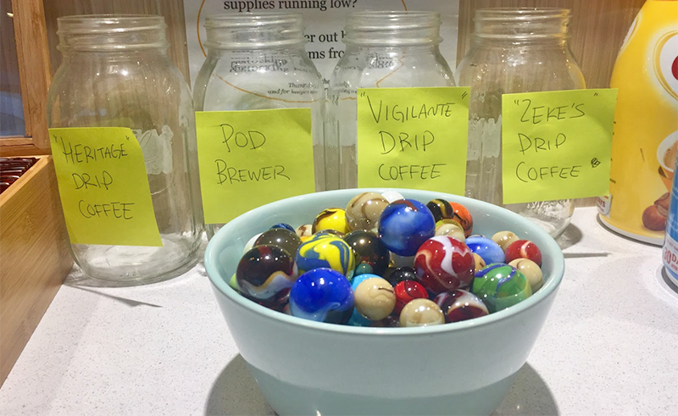
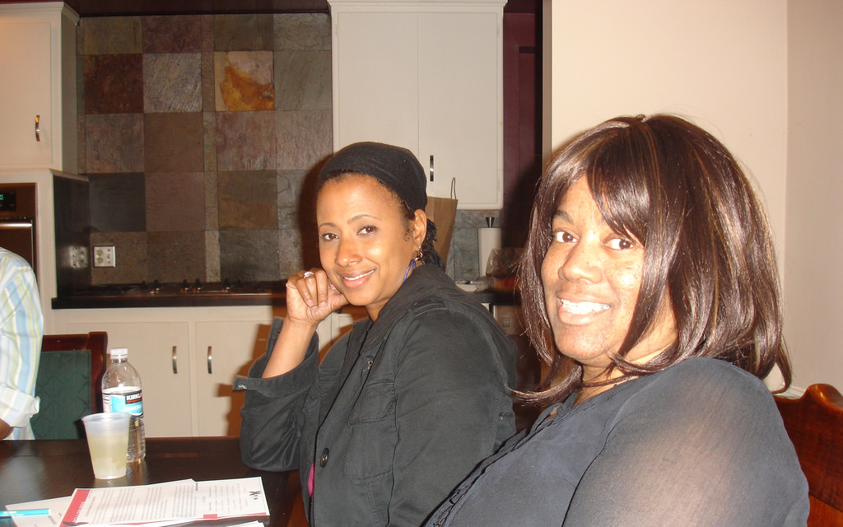
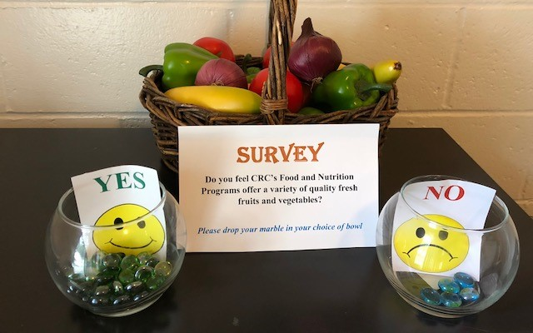
Gathering Client Input
1
2
3
Surveys
“Voting,” comment cards, journals, “Question of the
Listening tables or focus groups
4
Empathetic observation

Slide 33
^{Environment}
^{Clients are warmly welcomed} ^{and healthy options} ^{are easy to access.}
^{Cultural & Dietary} ^{Accommodations}
People of different backgrounds have access to food and information that fits their preferences and health needs.
^{Community} ^{Connections}
Pantries connect and collaborate with the community.
^{Nutrition} ^{Education}
Clients, volunteers, and staff have access to nutrition and culinary education.
^{Inventory &} ^{Purchasing}
Healthy foods are prioritized for distribution. Pantries support a variety of waste reduction efforts.
^{Nutrition Goals & Pantry Plans}
Policies and procedures are documented and align with a commitment to dignified, healthy distribution.

Slide 34
Environmental Shifts to Support Health
“Nudging” is creating small changes to the environment to influence healthy behaviors without eliminating choice. In a pantry setting, nudges can be used to help clients identify, select and utilize healthy or unfamiliar foods.

Slide 35
What foods should you highlight?
Fresh fruits & vegetables – especially those that are unfamiliar
100% whole grains (rolled oats, wild rice, barley, etc.)
Whole grain pastas, breads, tortillas, etc
Eggs
Nuts, seeds, beans, lentils with nothing added
Plain milk, yogurt, unsweetened alternative milks
Foods important to your clients

Slide 36
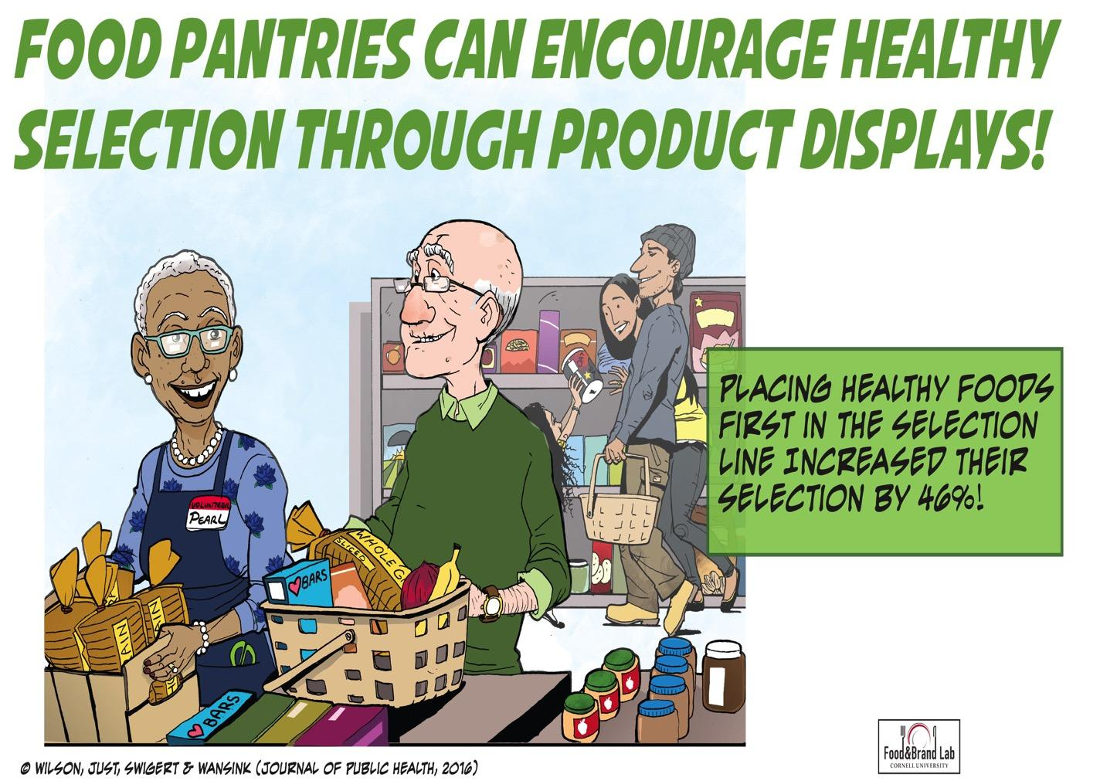
Notes:
*********************************************

Slide 37
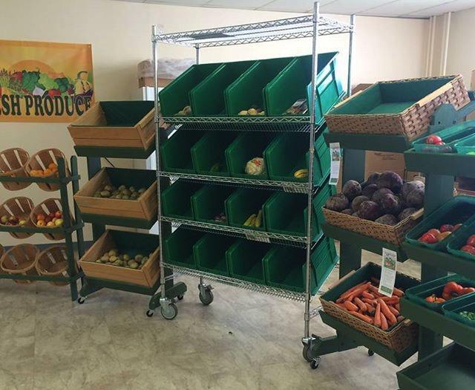
Using Nudges in All Types of Pantry Settings
Convenient
Attractive
Normal
Image from VT Fresh instagram @vtfreshprogram

Slide 38
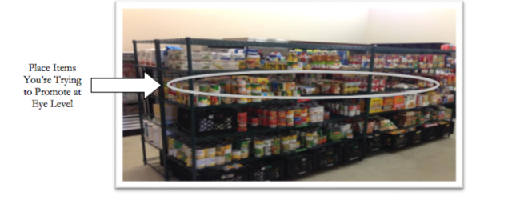
Convenience
Choice Pantries
Placement
Place fruits and vegetables before other foods in line.
Place healthy foods at eye level in easy to reach location.

Slide 39
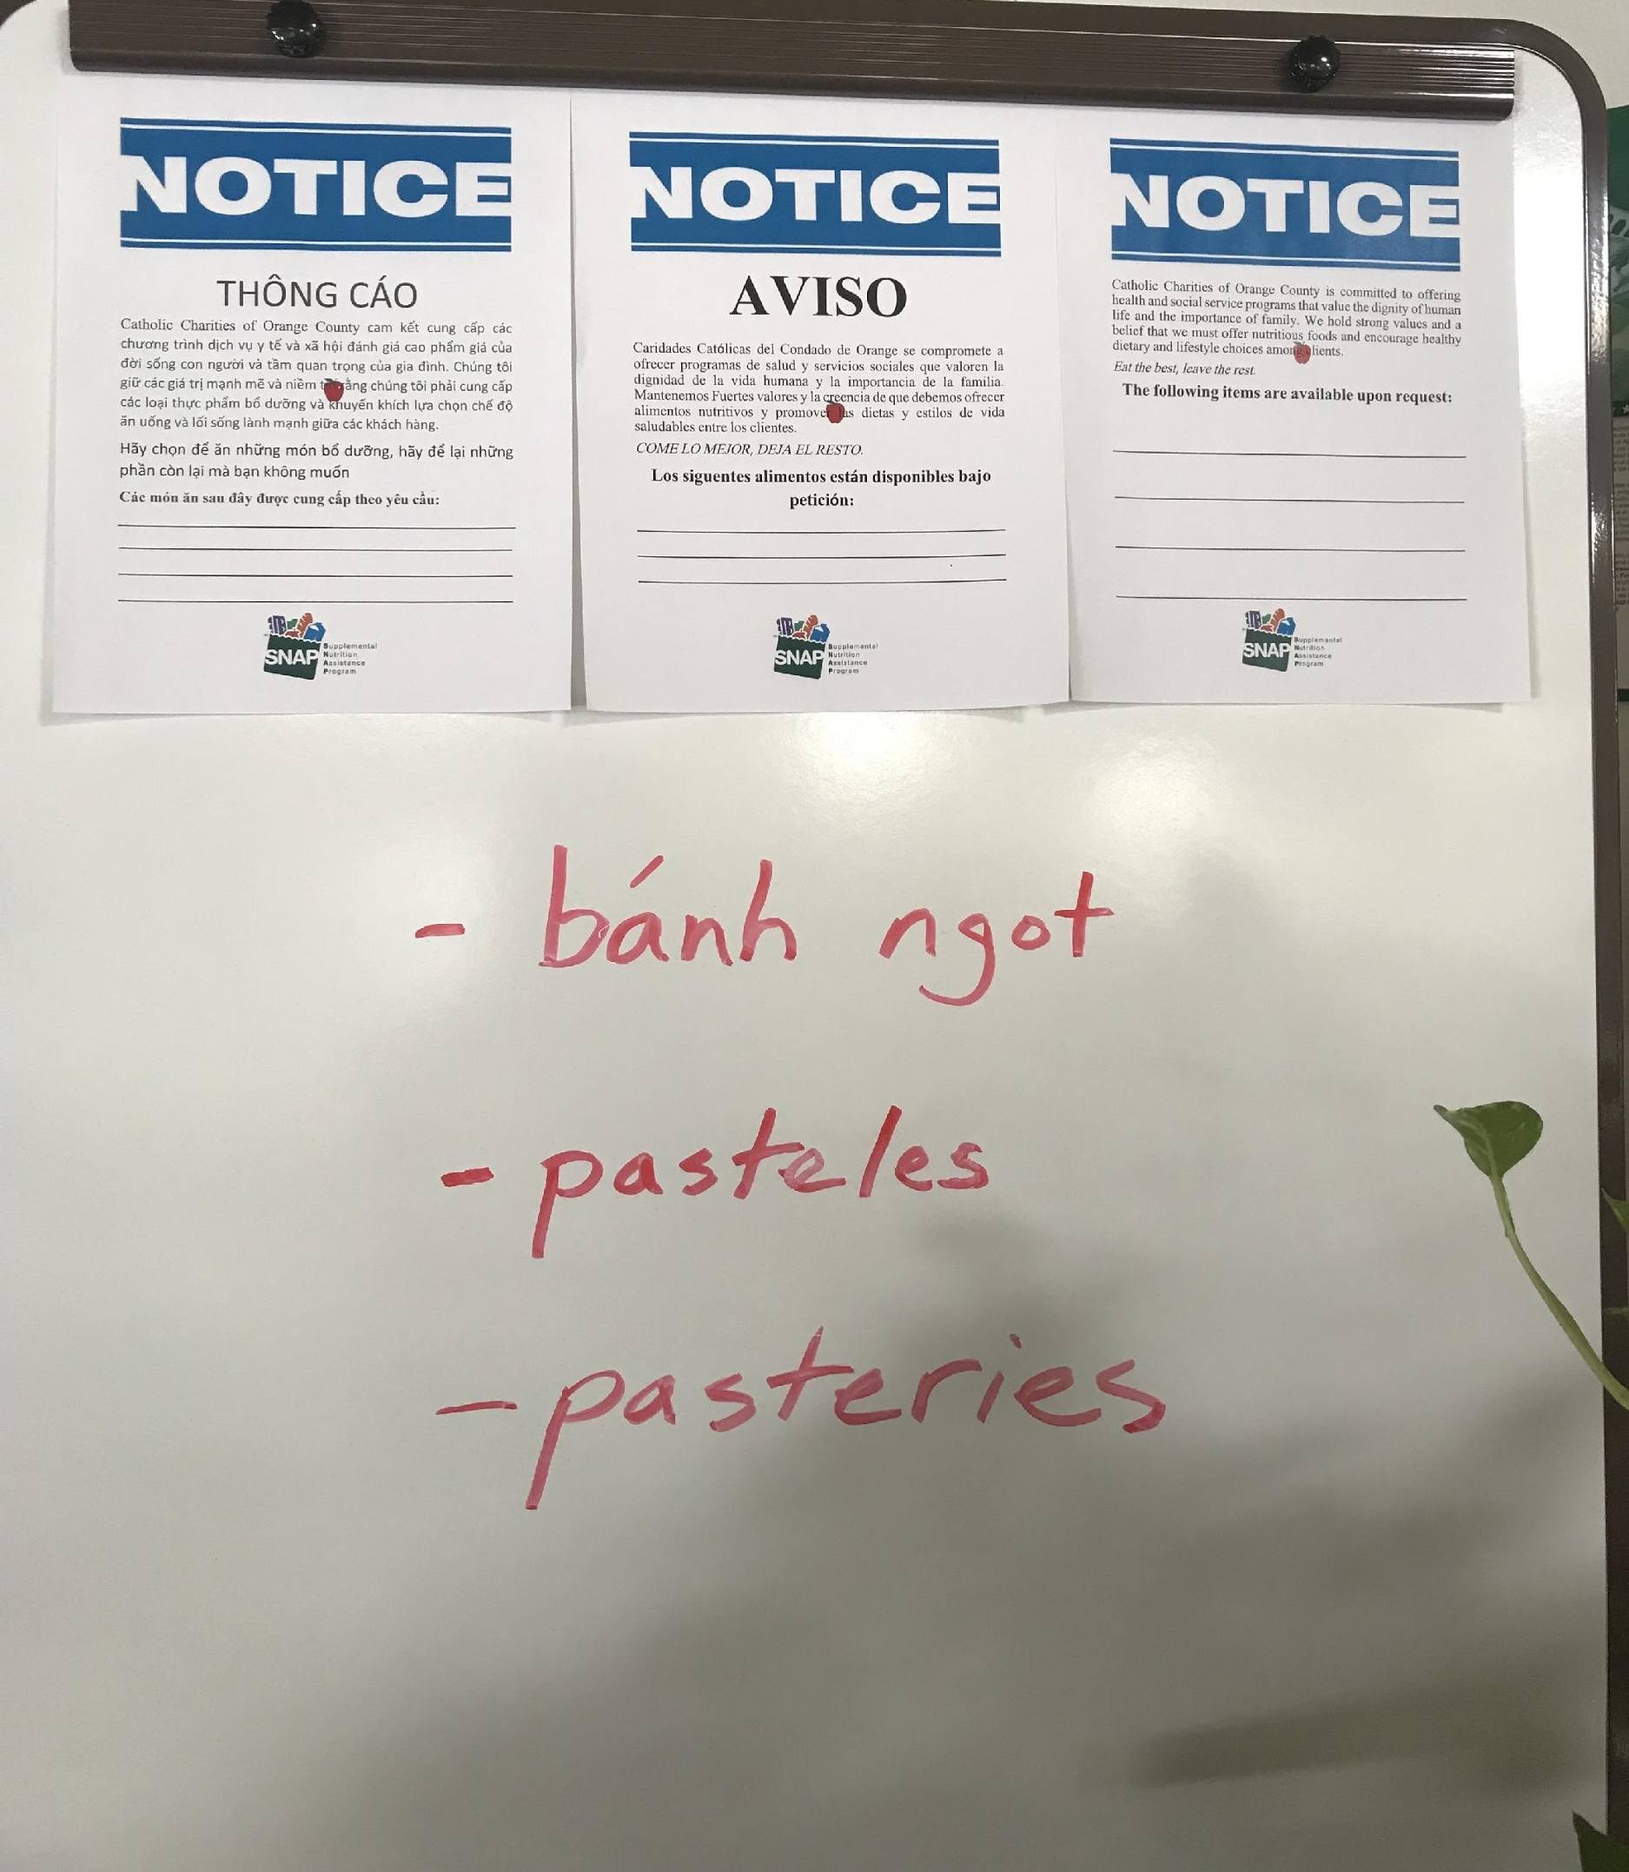
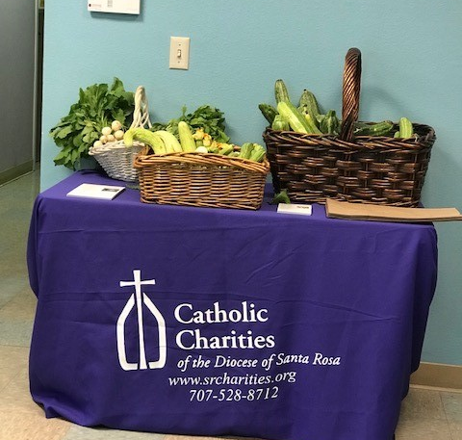
Convenience
Pre-Bagged Pantries
Placement
Make less healthy food available “by request”
Allow fruits & vegetables “by choice”
Catholic Charities
Orange County
Catholic Charities
Santa Rosa

Slide 40
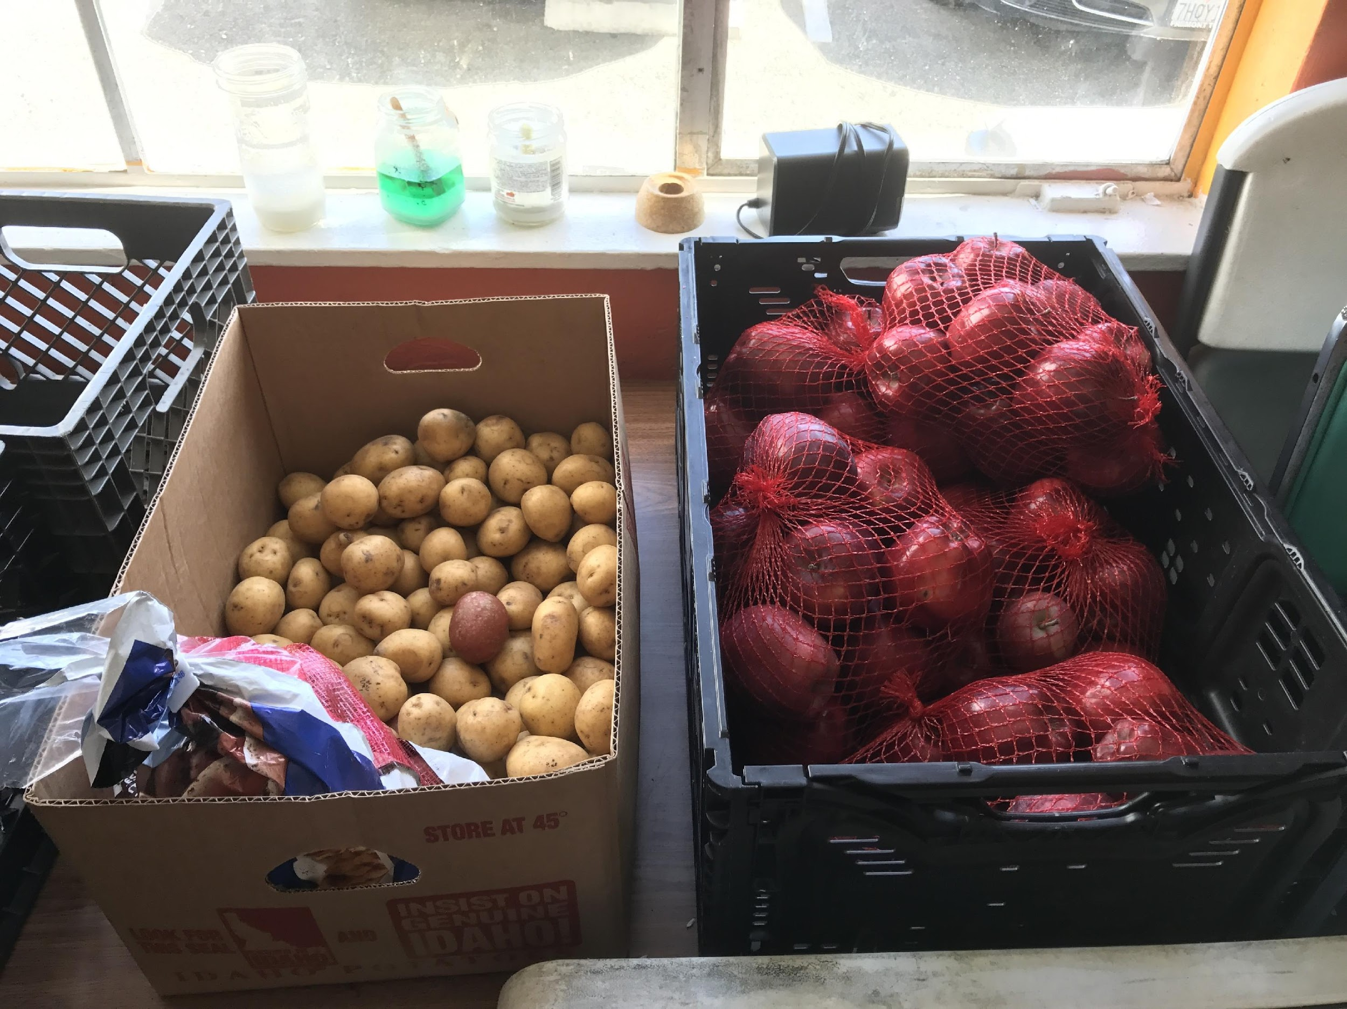
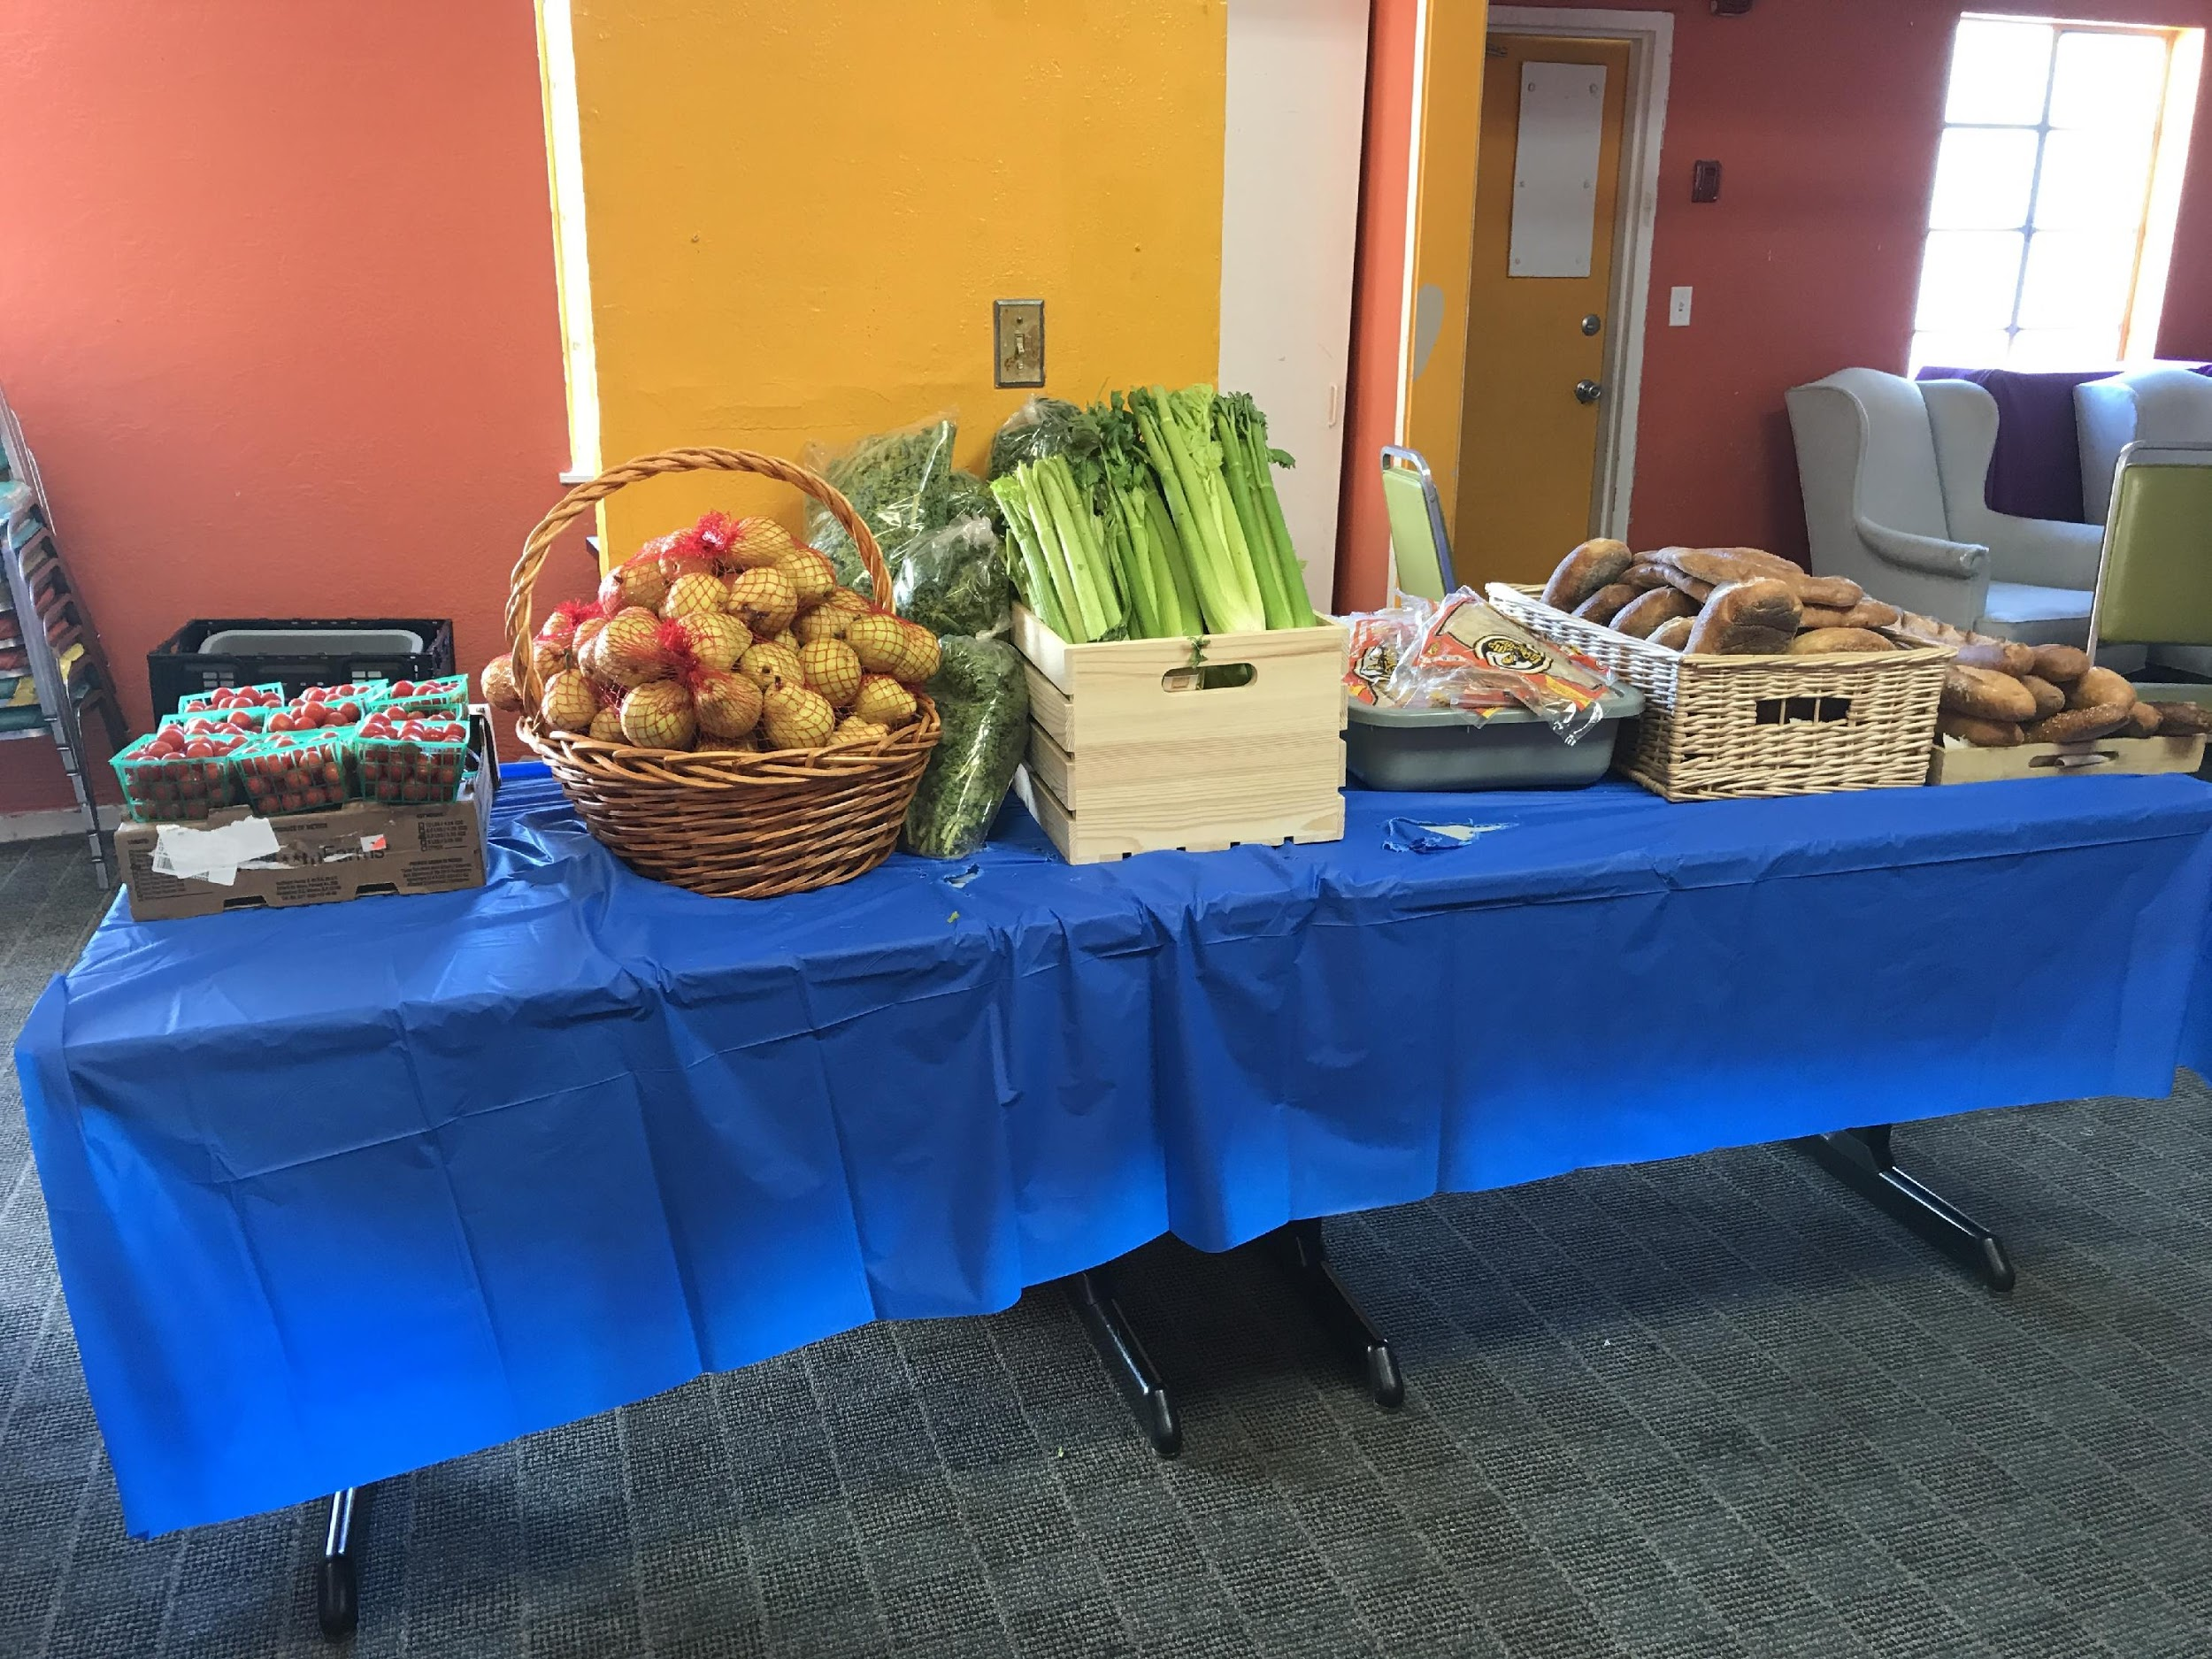
Attractive
Choice Pantries
Environment Upgrades
Simple upgrades to displays
Harbor House, Oakland CA

Slide 41
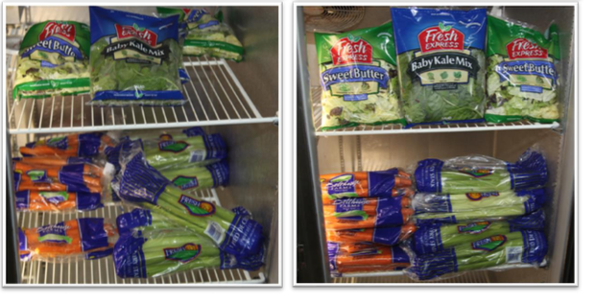
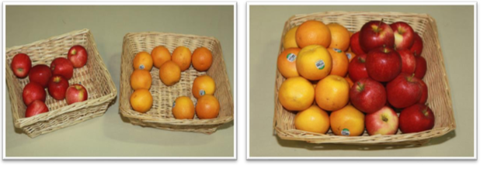
Attractive
Before
After
Choice Pantries
Environment Upgrades
Give the impression of abundance through “fronting” & consolidation
Before
After
Images from The Food Group “Merchandise Stocking Basics & Checklist”

Slide 42
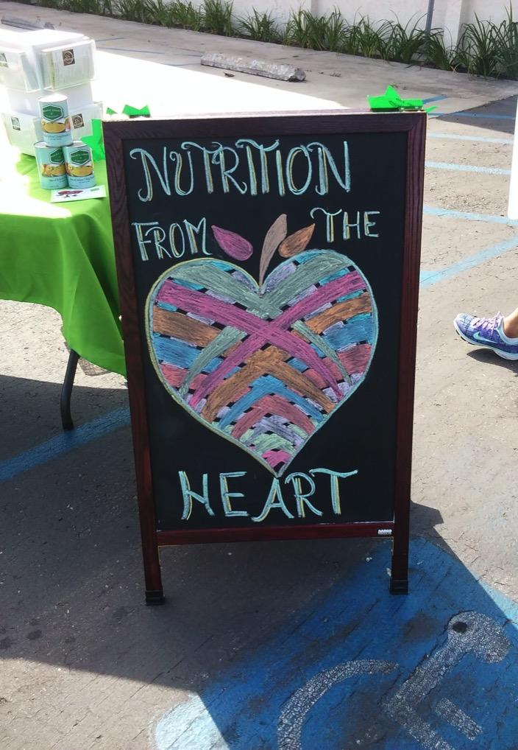
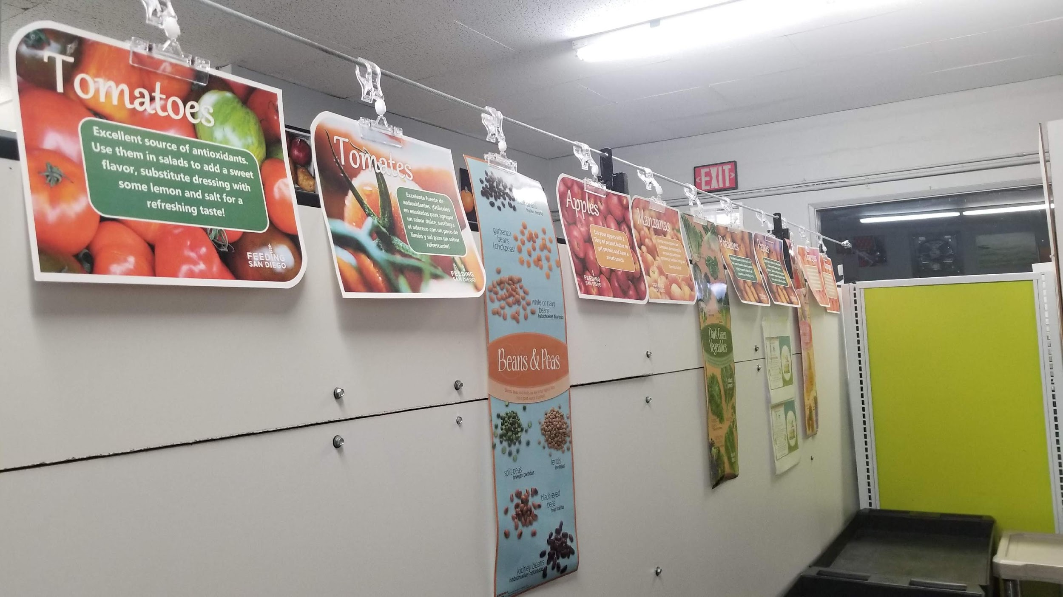
Attractive
Pre-Bagged Pantries
Environment Upgrades
Utilize colorful signage when possible. “Primes” clients.
Fallbrook
Food Pantry
Turning the Hearts, Chula Vista

Slide 43
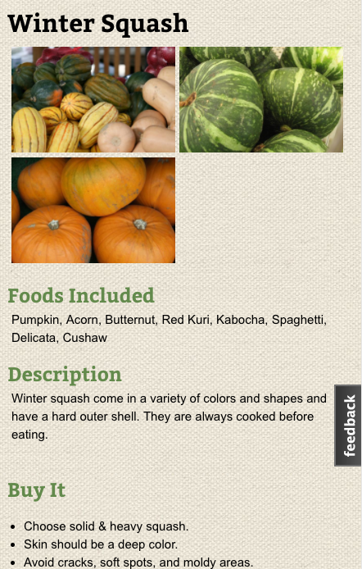
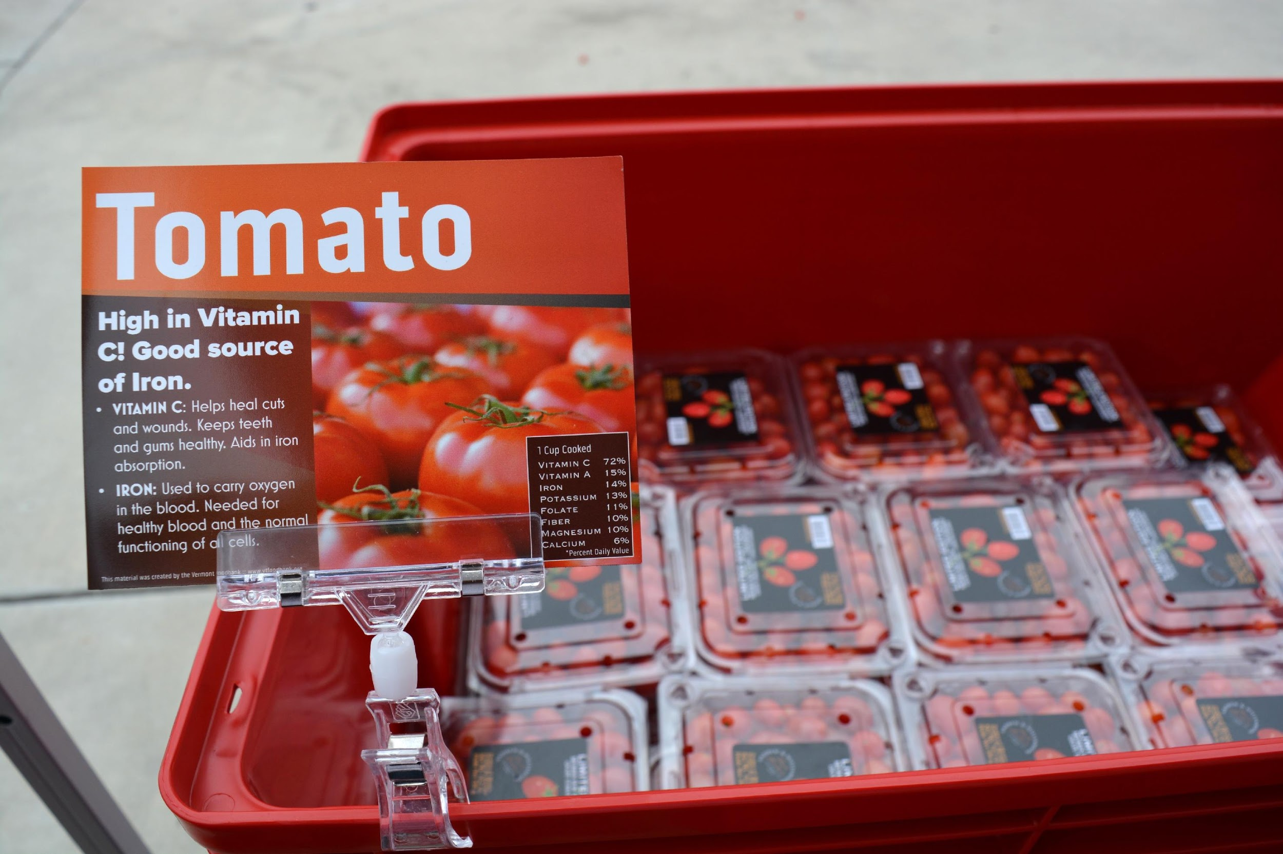
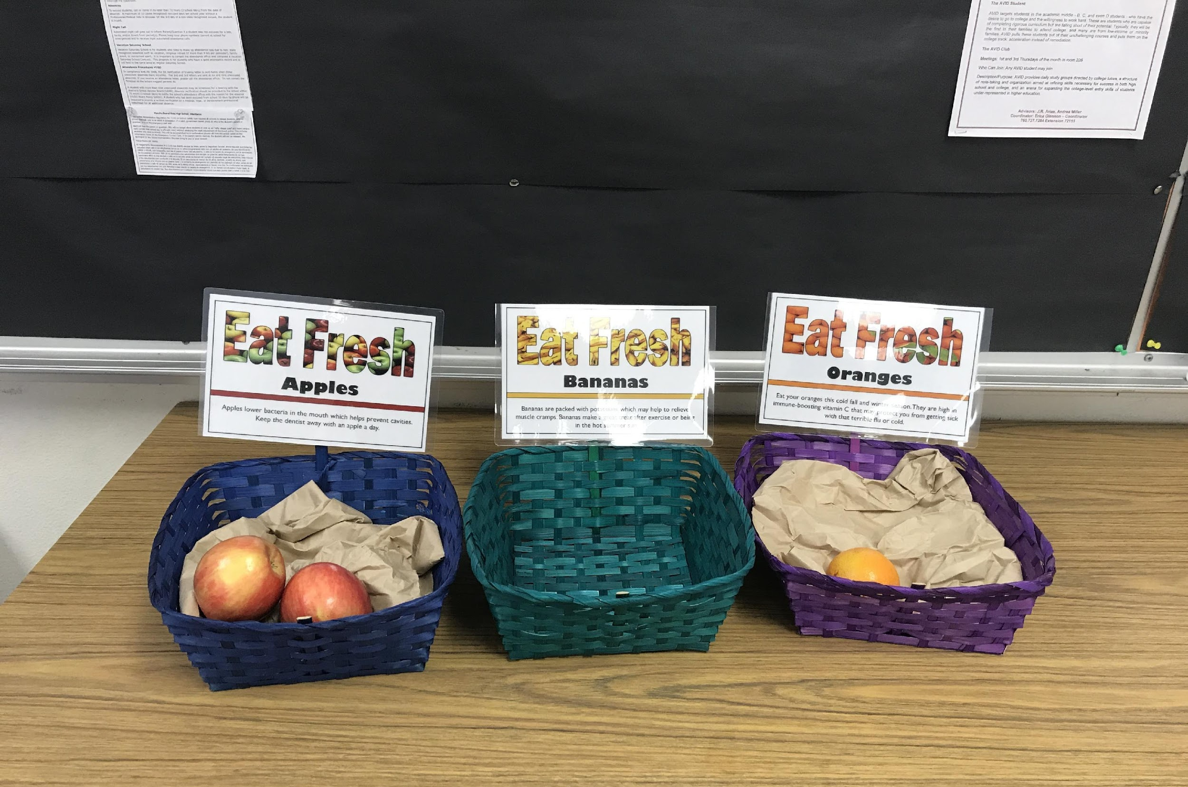
Normalize – How Do I Use this Food?
Choice Pantries
Signage
Use signs to highlight healthy, unfamiliar and underutilized foods

Slide 44
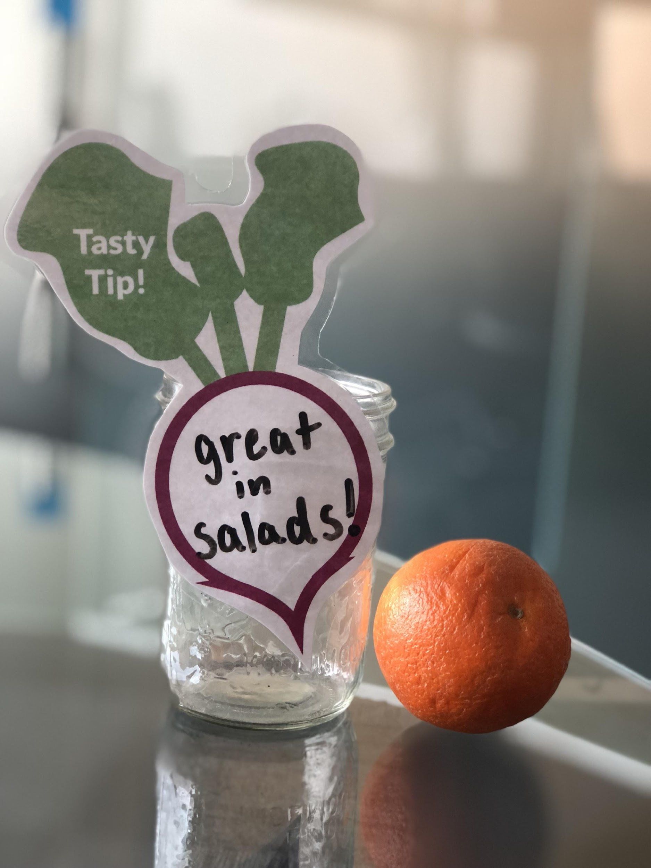
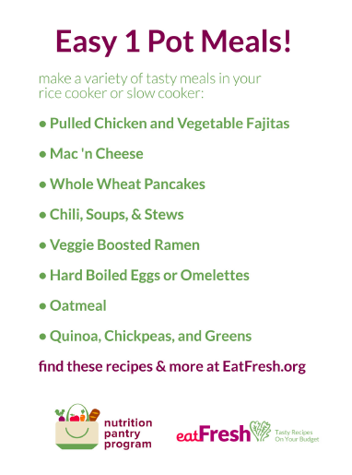
Normalize – How Do I Use this Food?
Choice & Pre-Bagged Pantries
Signage
Use signs to provide tips on preparation & usage

Slide 45
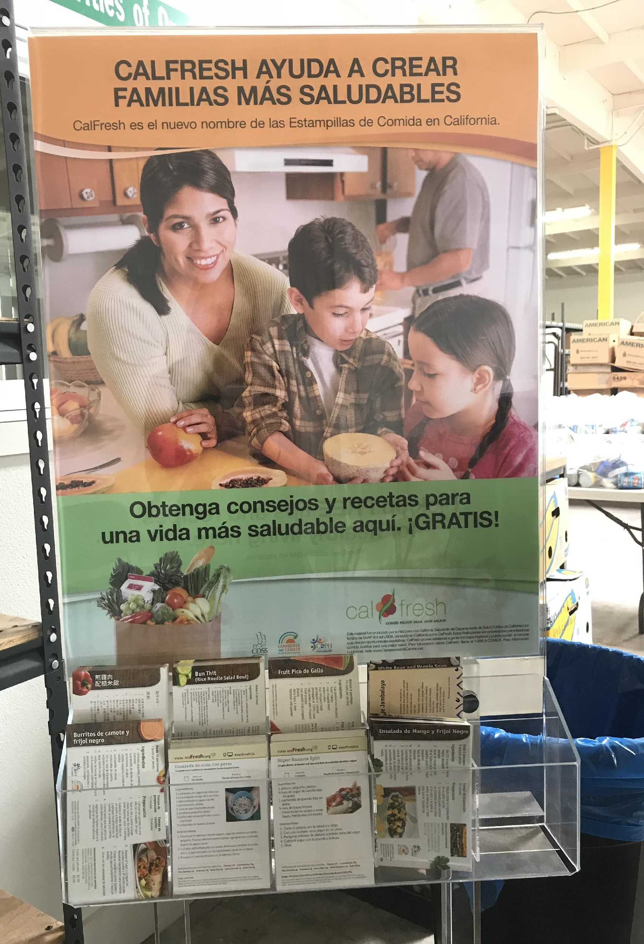
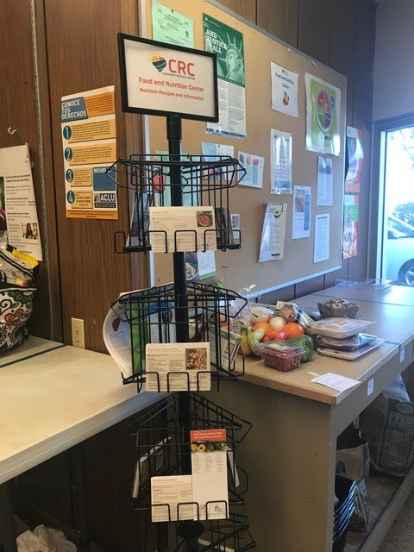
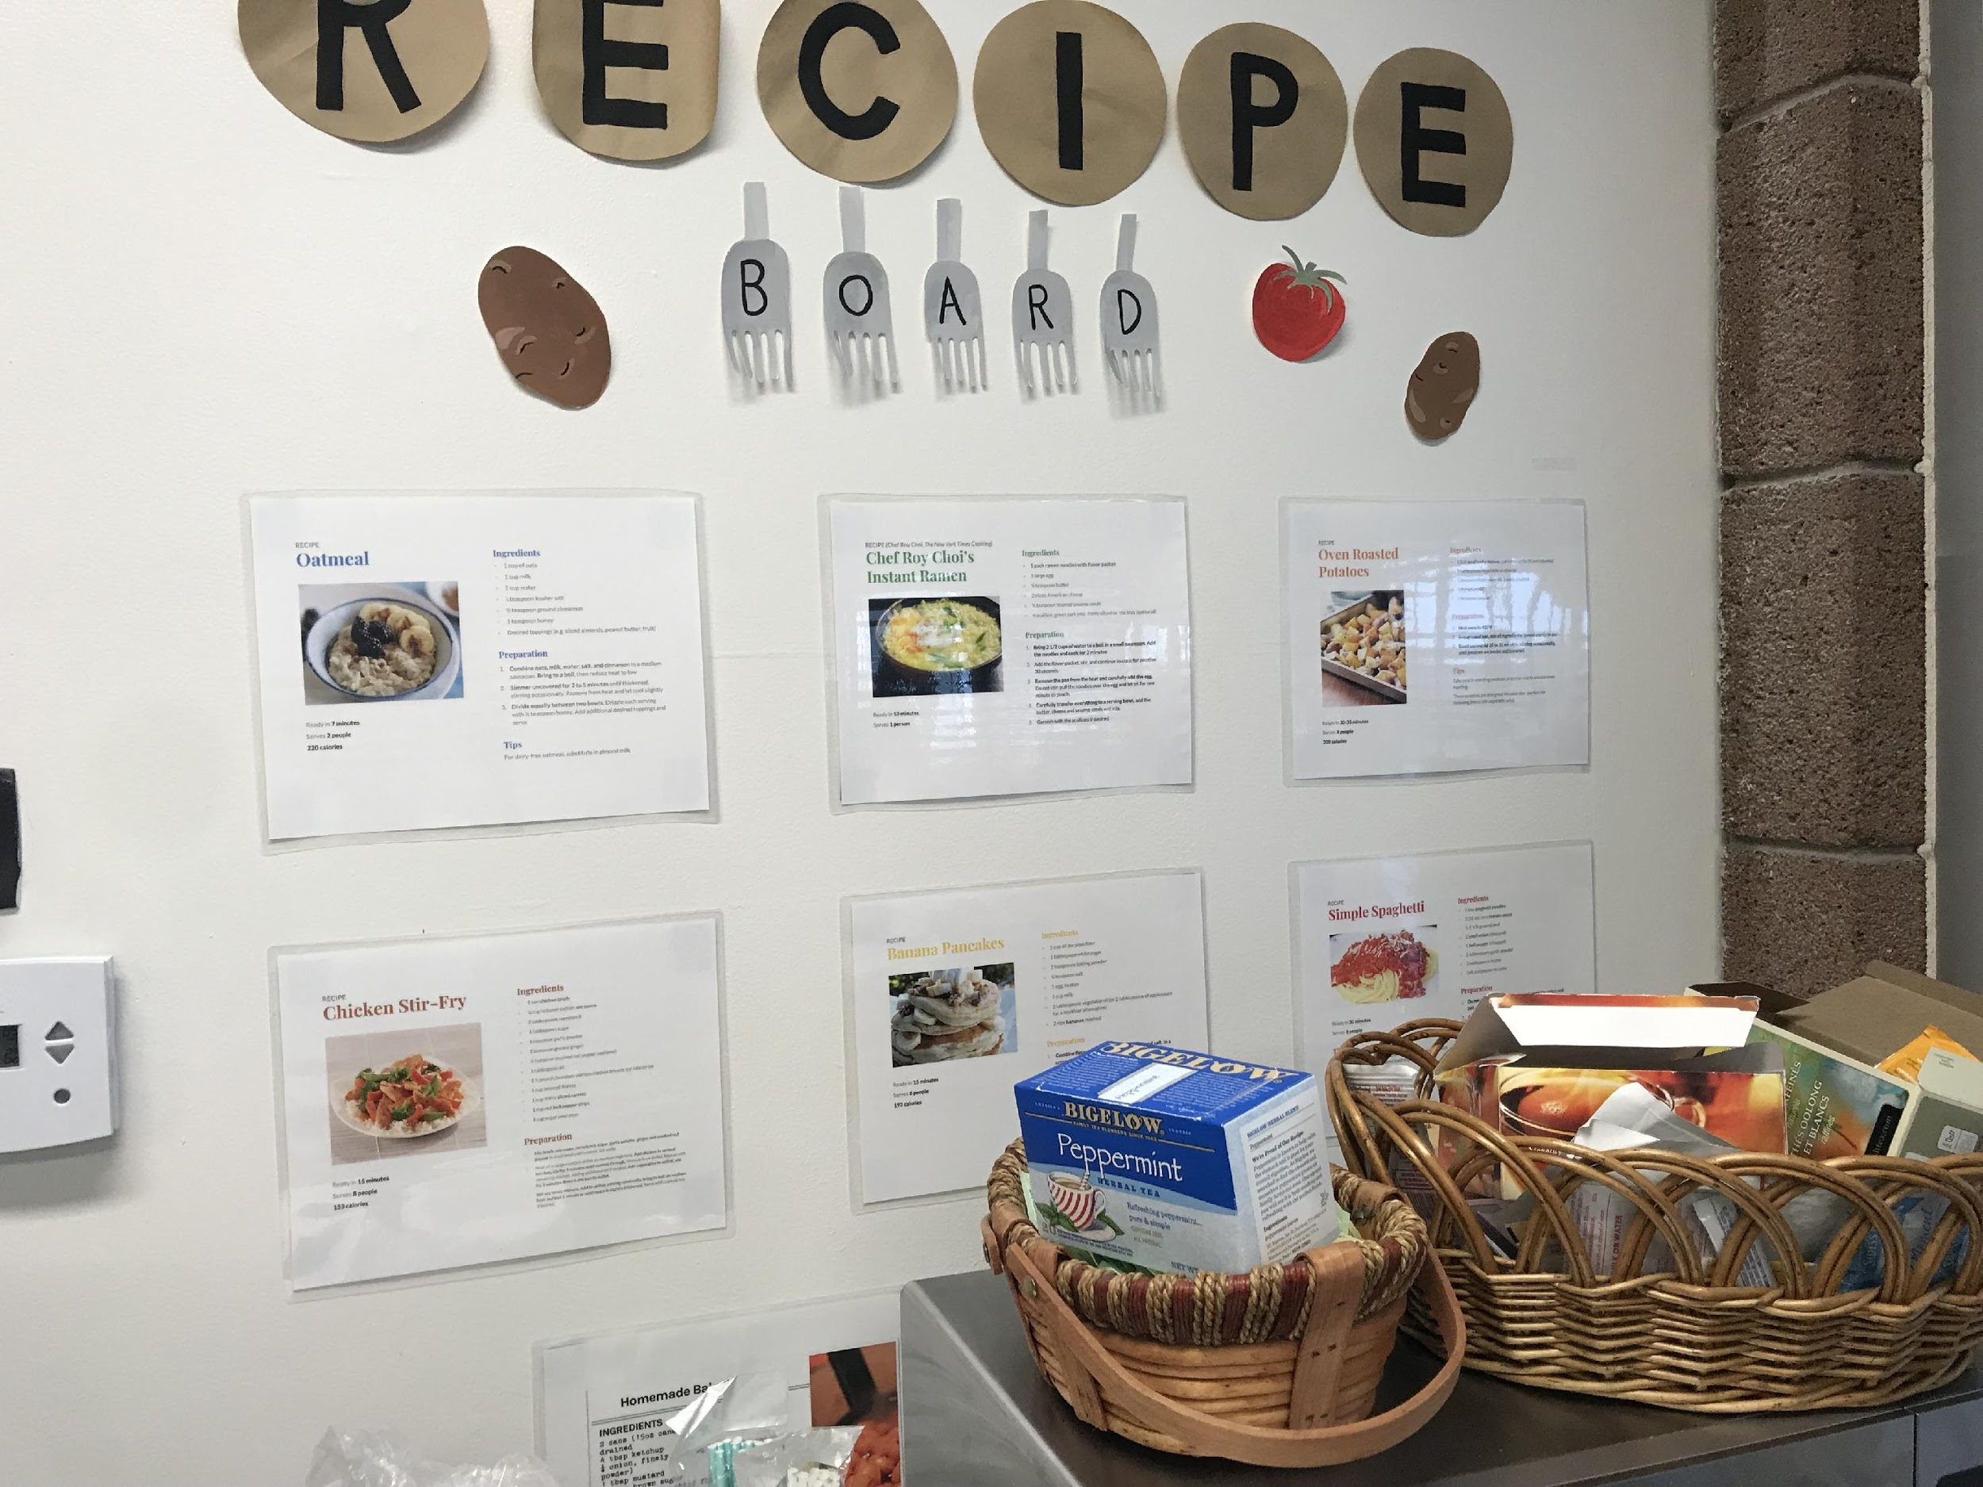
Normalize – How Do I Use this Food?
Choice & Pre-Bagged Pantries
Recipes
Provide recipes for common & uncommon foods
CC Orange County
CRC, Encinitas
UC Santa Barbara Pantry

Slide 46
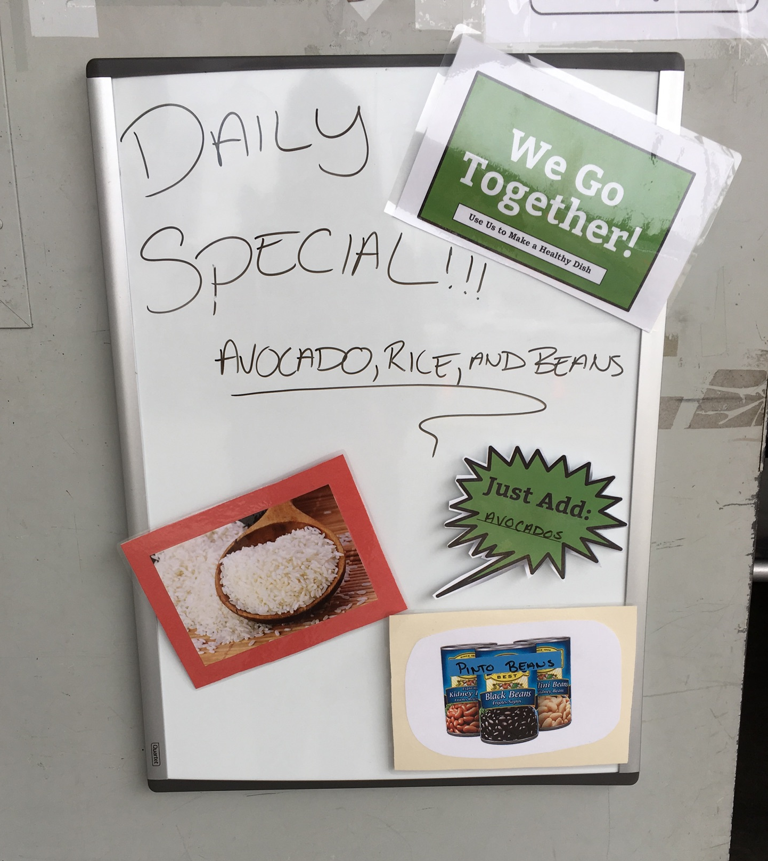
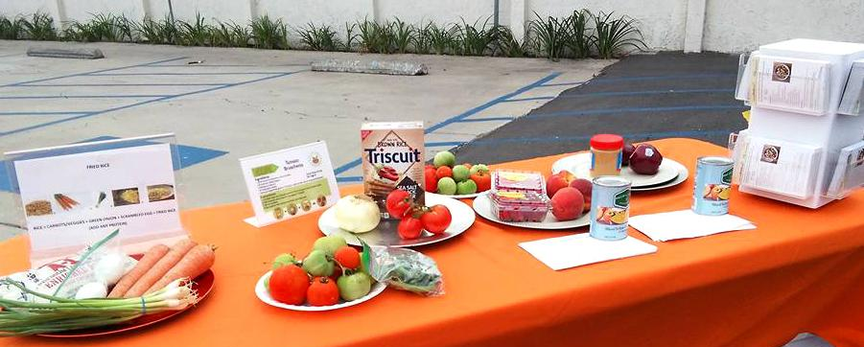
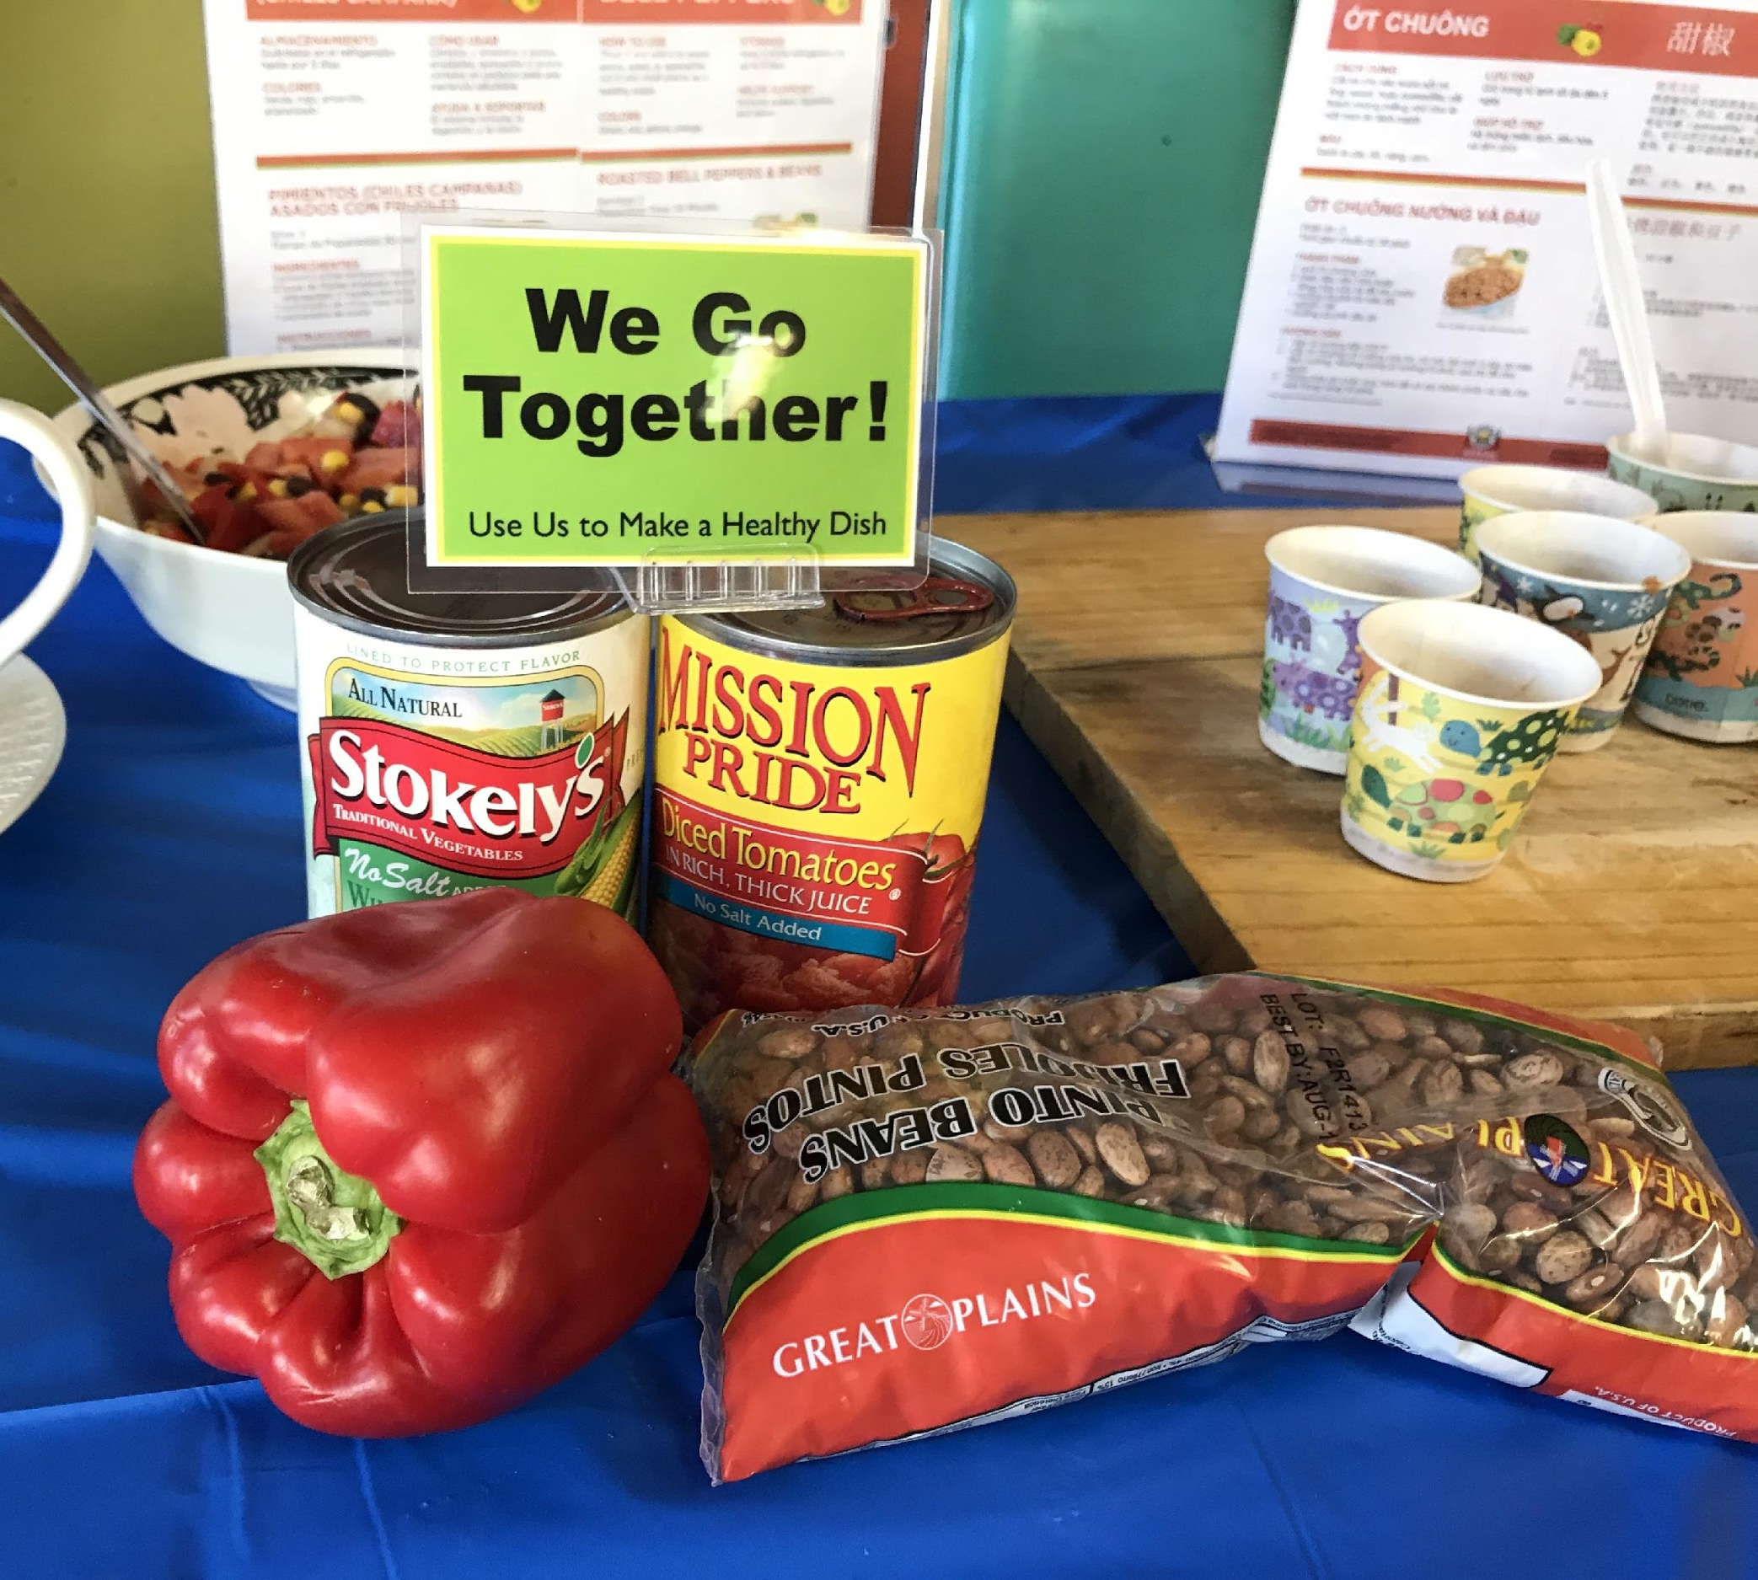
Normalize – How Do I Use this Food?
Choice & Pre-Bagged Pantries
Bundling
Provide snack & meal ideas by displaying pantry ingredients
CC Fresno
Harbor House
Oakland
Turning the Hearts, Chula Vista

Slide 47
Bundling Activity

Slide 48
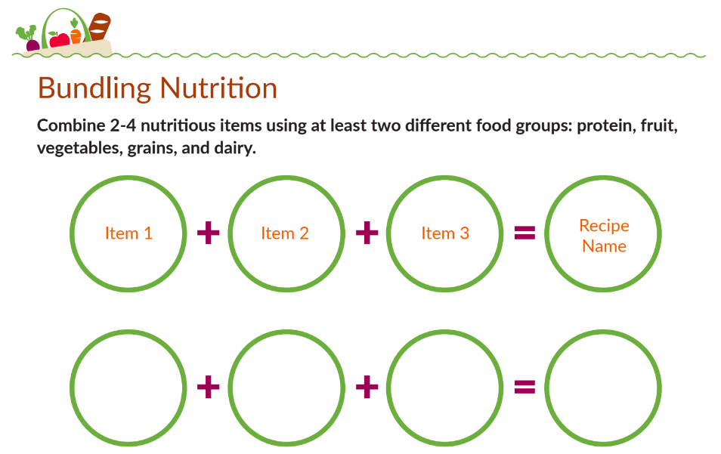
Bundling Activity - Your Turn!

Slide 49
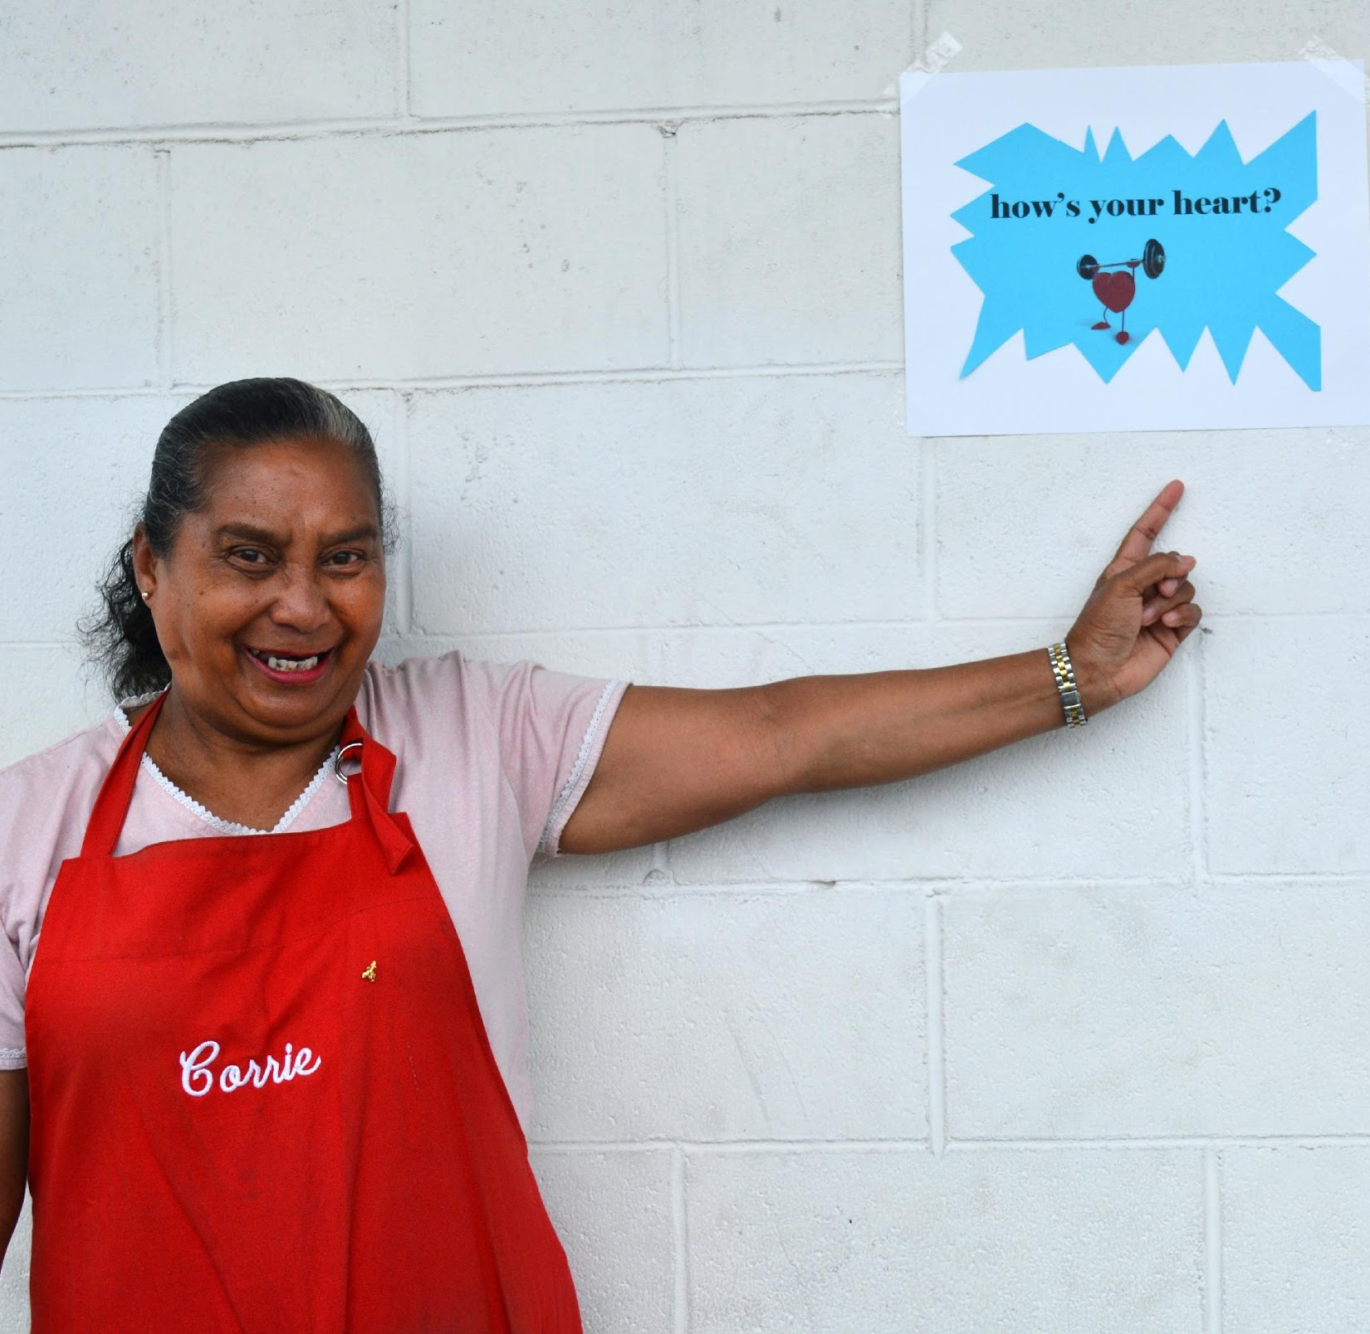
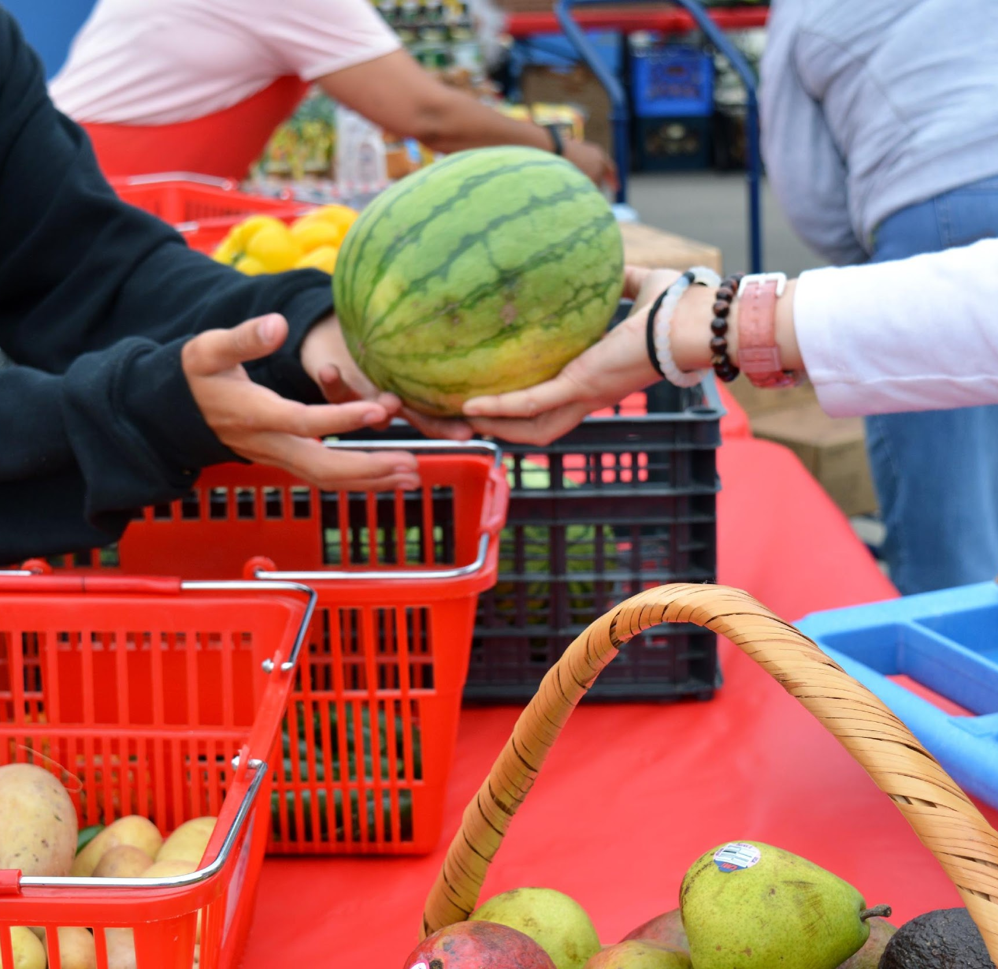
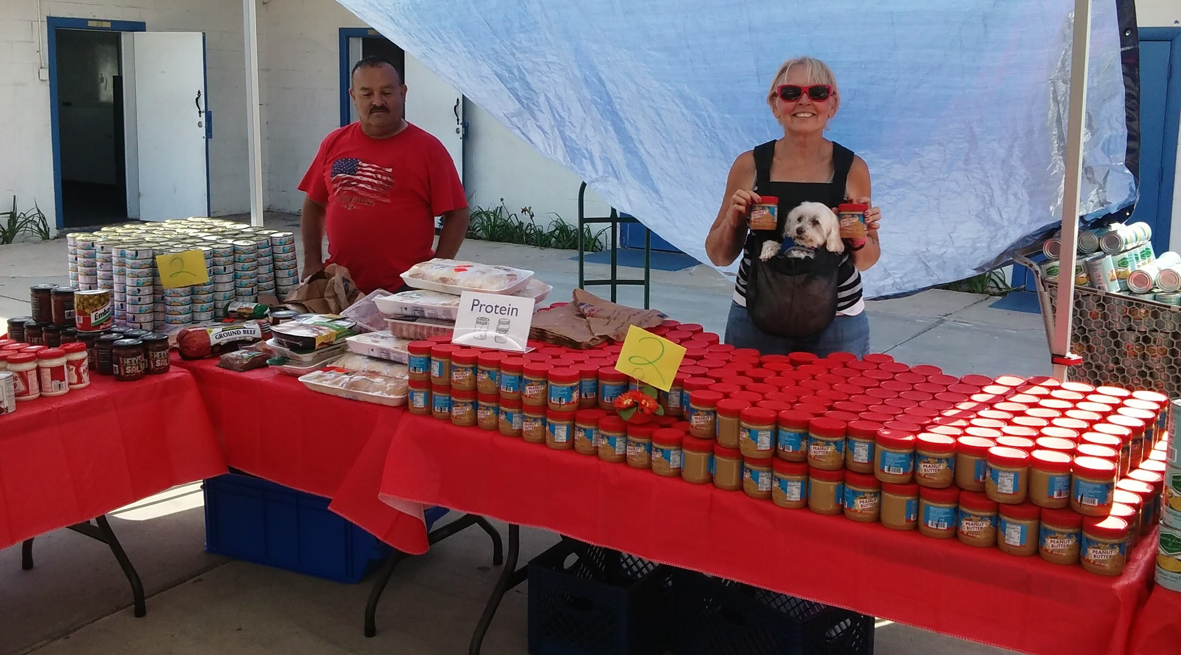
Normalize – How Do I Use this Food?
Choice & Pre-Bagged Pantries
Use staff & volunteers as nutrition advocates

Slide 50
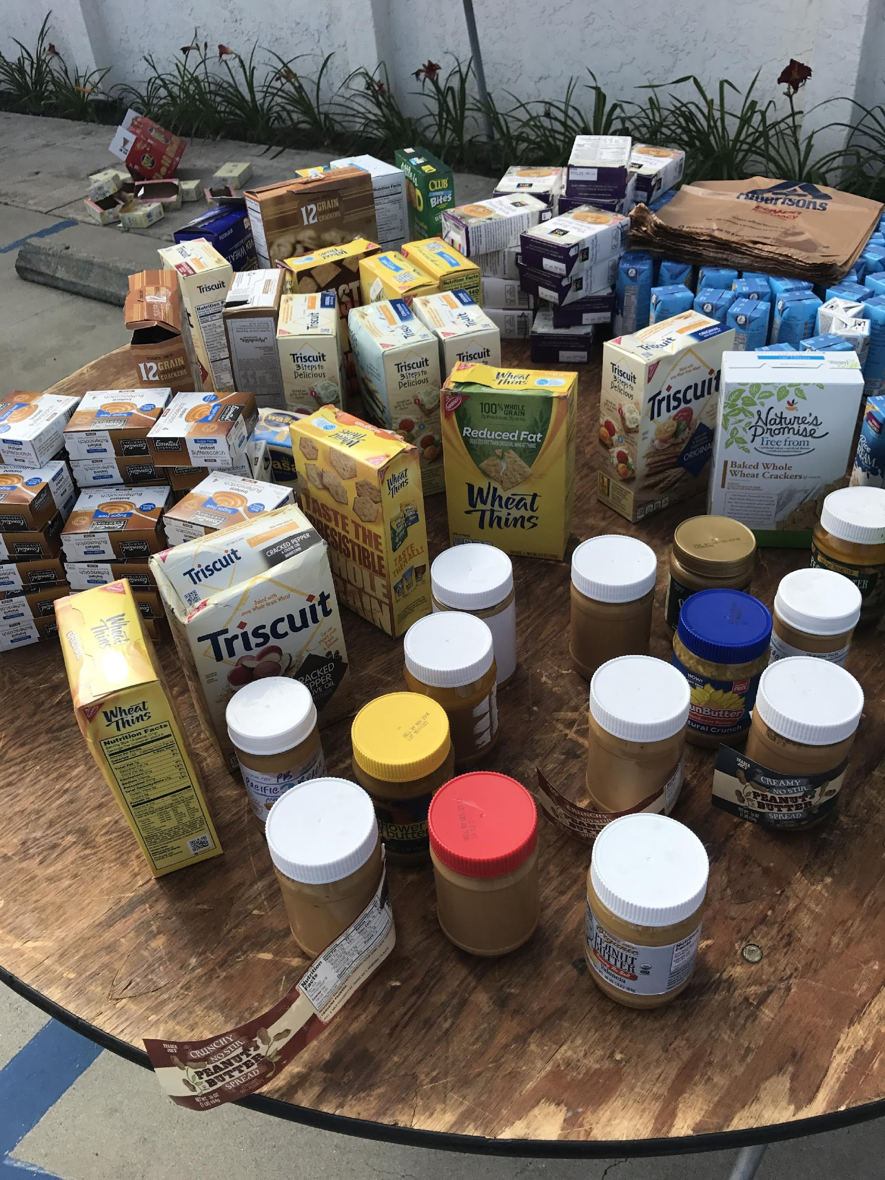
Normalize
Pre-Bagged Pantries
Promote choice & reduce waste by providing a swap or discard table

Slide 51
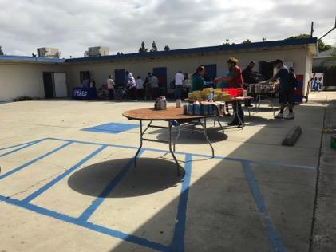
Turning the Hearts: Before
And After…

Slide 55
Awarded SDFSA Cold Storage Mini-Grant + NPP Gold Level Certification

Slide 56
Supporting Nutrition and Health through Online Resources:
An Introduction to EatFresh.org

Slide 58
Heal Bruised Produce Back to Life
Notes:
“Apples and oranges that are bruised and mealy”

Slide 59
Healthy Twist on Client Favorites
Notes:
What food items or meals are most popular with your clients?

Slide 60
Canned Goods CAN be Tasty
Notes:
Survey Feedback:
Common foods distributed: canned goods, vegetables, beans Souped Up Soup: This recipe came from an SRO resident who wanted to make a common food pantry item healthier.

Slide 61
Recipes for common pantry foods
Notes:
Survey Feedback:
Common foods distributed: canned goods, vegetables, beans Souped Up Soup: This recipe came from an SRO resident who wanted to make a common food pantry item healthier.

Slide 62
Recipes in multiple languages
Notes:
Survey Feedback:
Common foods distributed: canned goods, vegetables, beans Souped Up Soup: This recipe came from an SRO resident who wanted to make a common food pantry item healthier.

Slide 63
How can you use EatFresh.org within your programming?
Recipes
Use recipes for food demos & workshops
Hand out recipes highlighting foods that are being distributed
Discover New Foods
Print out pages for lesser-known foods
Lifestyle Pages-
Basic Nutrition Messaging: Eat the Rainbow, Use MyPlate to build a healthy diet
Food storage, food code dates
Ask a Dietitian

Slide 64
What’s your tiny change?

Slide 65
Contact Us
Ruthi Solari
ruthi@leahspantry.org
www.LeahsPantry.org

